Slide 1
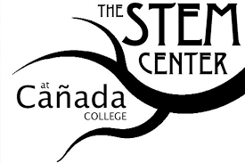
Training Research Activities Bettering Access to Job Opportunities (TRABAJO)
Sharon Quach, MA
STEM Career Exploration Program Coordinator

Slide 2
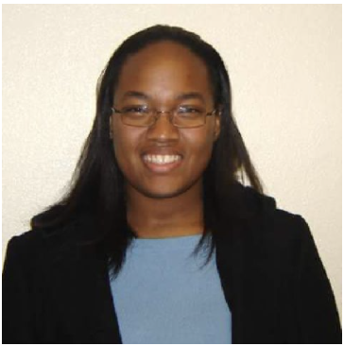
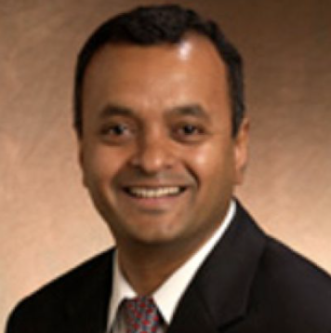
Project Leads
Marcella Grant
grantm@smccd.edu
Assistant Project Director
Professor Ramki Kalyanaraman (PI)
kalyanaramanr@smccd.edu
STEM Faculty
Sharon Quach
quachs@smccd.edu
Career Exploration Coordinator

Slide 3
TRABAJO Overview
National Science Foundation – Improving Undergraduate STEM Education (IUSE - HSI) ​
​
5-year grant period​
$1,622, 224 (Approximately $325,000/year)​
​

Slide 4
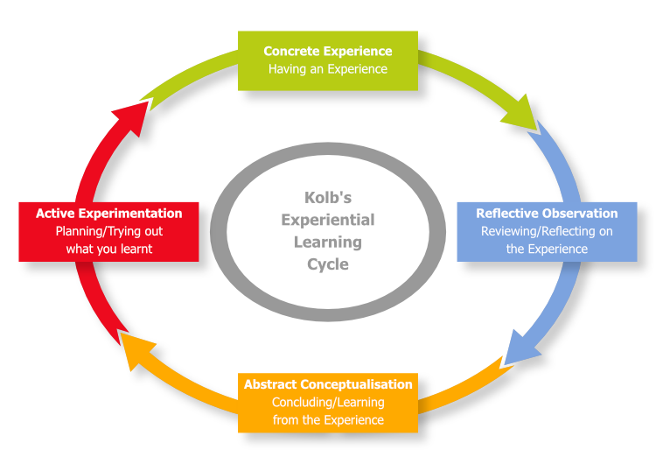
TRABAJO VISION
The mission of TRABAJO project is to increase STEM students’ self-confidence, motivation and strengthen career knowledge through experiential learning opportunities:
Classroom visits
Job shadow
Internships
“Learning is the process whereby knowledge is created through the transformation of experience” (Kolb, 1984, p. 38).
Notes:
Continue to enhance and align industry- practice of teaching specific career skills.
Indiv. Will go through four stages of learning and four seperate learning cycle
The motivation for incorporating experiential learning into career development opportunities is grounded in the well-established concept of self-efficacy.
Albert Bandura (1994) described how practicing and experiencing a specific task will lead to increased confidence in a person's ability to perform this task, and this positive belief in oneself feeds back into better performance of the task at hand.
Self-efficacy is experience-based and serves as a foundation for successful performance (Lent et al., 1994). Indeed, at the undergraduate level, hands-on research experiences have proven effective in building self-efficacy and research skills, two variables that can predict student aspirations for research careers (Adedokun et al., 2013).
Following this logic, opportunities to experiment with careers with which they were previously unfamiliar, even on a small scale, can lead to trainees' increased self-efficacy and enhanced confidence in career decision making.
This concept further maintains that even rejection of a career path, after the small-scale career experience, is a valuable outcome, as it will prevent a trainee from making an uninformed job commitment, which might ultimately lead to disappointment, frustration, disengagement, and underperformance.

Slide 5
Literature Review
Research with student groups at our college has highlighted the confusion students experience about selecting academic majors and careers. Students frequently do not understand what professions and job opportunities are available within academic disciplines. In addition, first-generation and underrepresented minority (URM) students often do not have direct contact with adults in STEM careers as role models (Brown, 2017).
Research internships are an effective means of deepening commitment to STEM careers. Independent research experiences increase students' engagement in their education, enhance research and laboratory skills, improve academic performance, increase understanding and interest for their discipline, strengthen oral and written communication skills, enhance problem solving, critical thinking skills and enhance self-efficacy.
Colleges and universities across the nation are using job shadowing experiences to help students determine career choices and increase motivation. Job shadowing can also showcase the connection between classroom learning and various careers. Job shadowing can benefit employers by enabling stronger relationships with college students, which can aid their overall recruitment efforts (cross-sector enhancement),

Slide 6
Research Questions Posed
How can strong cross-sector partnerships be developed and sustained between a community college and local industry?
Effectiveness of stepwise approach
What is the impact of career exploration activities (site visits, job shadowing, and internships) on student motivation, participation in support activities, and academic success?
Notes:
The gradual progression of commitment required of STEM employers could be a very successful strategy of developing partnerships with industry. Inclusion of alumni at all levels of the career exploration programs will build connections between college and industry and contribute mentorship to current students. This approach is designed to build the capacity of colleges to offer career exploration, which could be particularly effective with URM and first-generation students.
Ultimately, given the College's HSI status, this will produce a more diverse STEM workforce. By collaborating with industry partners, we will demonstrate how this cross-sector alliance can benefit both students and businesses. Students gain confidence in their career choice and motivation to pursue STEM careers. Businesses will be helped with recruiting of employees, and students will get a boost towards their first professional job

Slide 7
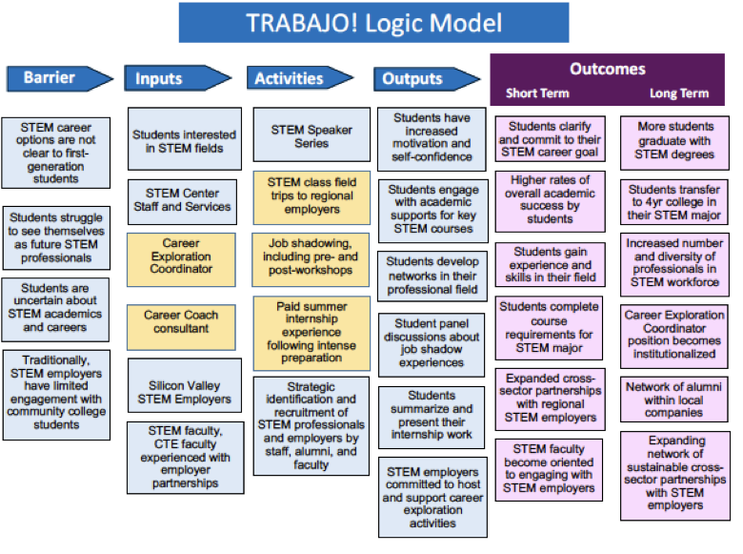
Notes:
GOALS: Our immediate goal is to give students the opportunity to learn about and experience professional jobs, with the ultimate goal of increasing their motivation and subsequent success in their STEM careers. In order to achieve this, we plan to develop innovative cross-sector partnerships with STEM professionals in industry and research institutes.

Slide 8
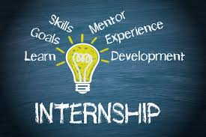
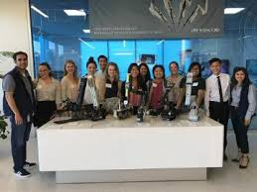
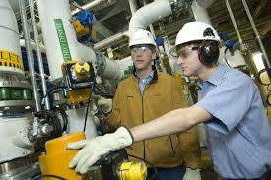
TRABAJO DESIGN ACTIVITIES DELIVERABLES
Research institute
and industry partner internship placements
10 sites by 1st year
5 every subsequent
Job shadowing & industry observations
10 sites by 1st year
5 every subsequent
40+ students by year 5
Class visits to job sites
5 annually
Notes:
We want students to recognize the application of academics on the job market, analyze their interests and abilities, interact with professionals, and reflect on their experience

Slide 9
FACULTY COLLABORATION
Internship Selection Criteria
Students will be identified and recruited through STEM courses, beginning in the second semester of their first year at Cañada
2.5 minimum GPA
Grit and growth mindset
Personal statements
Interviews
Faculty recommendations
Pre-internship Workshop Curriculum
Developed jointly with PI and STEM faculty. The CE will conduct four workshops following mathematics block on Fridays. Targets to prepare students with little lab/ research experience.
Workshop topics include:
Applying for Internships
Introduction to Research process
Library session on conducting literature reviews
Standard lab documentation practices, data analysis, and presentation

Slide 10
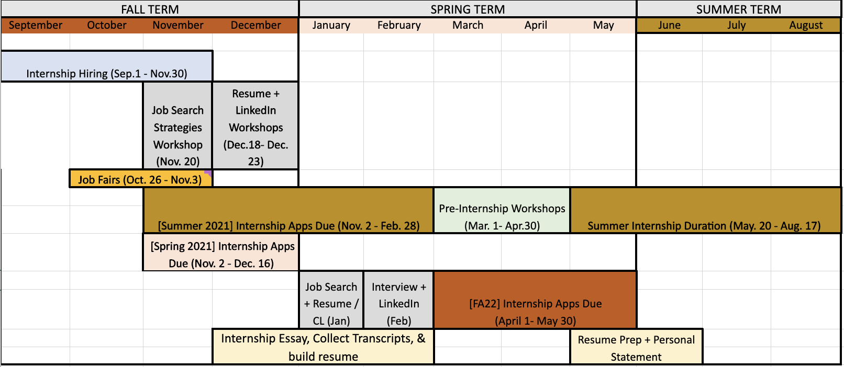
PROJECT TIMELINE- SUMMER INTERNSHIPS

Slide 11
FACULTY INVOLVEMENT- FIELD SITE VISITS
Targeted Intro Courses
ENGR 100
BIO 230
MATH 225
ENVS 115
CIS 118

Slide 12
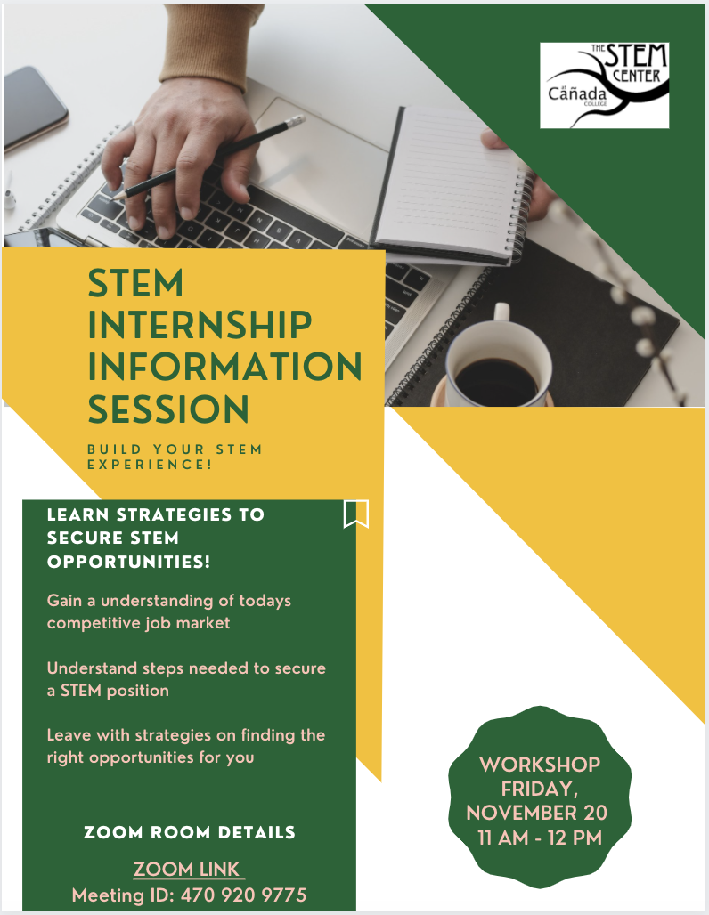
Career Exploration/ Job Preparation Resources
TRABAJO Next Steps
Update STEM Internship & Job Board (completed)
Career Plan Checklist (in progress)
Major Exploration Resources (in progress)
Internship & Job Search Guide (in progress)
STEM focused job search strategies - 11/20
Job Shadowing Planning (Spring 21)
Worksite Visites (Spring 21)

Slide 13
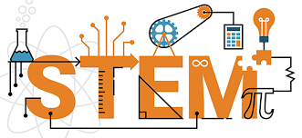
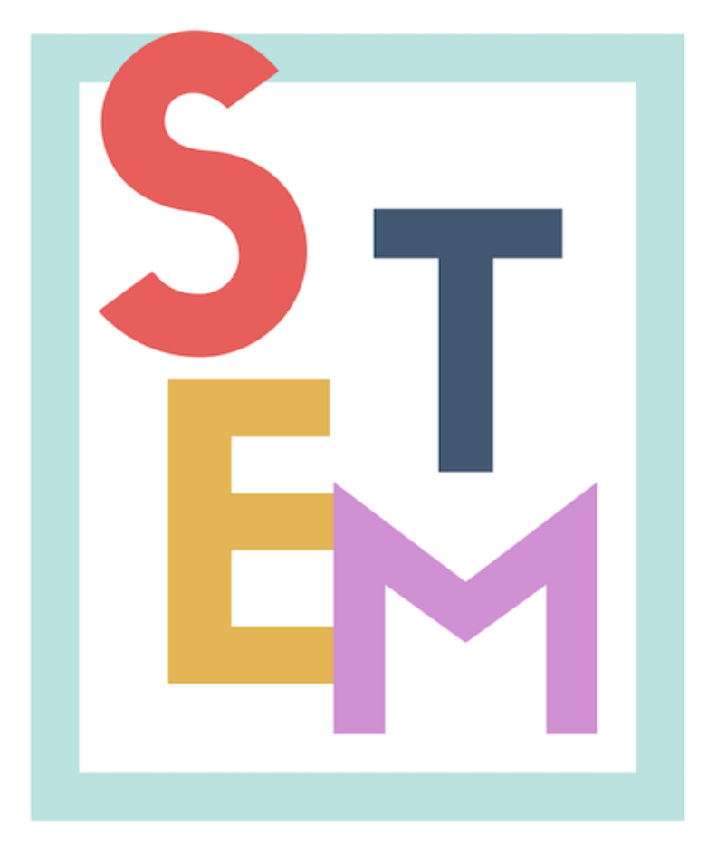
Thank You!

