Slide 1
Reimaging Student Access to Career Opportunities Work Group Agenda October 5, 2023 11:00 – 12:30 p.m.
Room 8-119 or on Zoom: https://smccd.zoom.us/j/83407218071

Slide 2
Welcome & Instroductions
Name | Title
Karen Engel | Dean of Planning, Research, Innovation & Effectiveness
Hyla Lacefield | Dean of Business, Design & Workforce
Janhavi Pendse | Interim Workforce Development Director
Max Hartman | Dean of Counseling
David Gainey | Project Director of Apprenticeships
Bob Haick | Program Supervisor (Career Center) and Assistant Professor - Counseling
Mercedes White | Program Services Coordinator - Menlo Park
Career Counseling Aide | hiring
Ron Andrade | Guided Pathways Director
Rance Bobo | Program Services Coordinator, STEM Center
Alex Jones | Adjunct Faculty - Cooperative Education
Others we can invite?

Slide 3
Who will do what on Priority #4?
Priority #4: Reimagine how we support students’ accessing career opportunities
Work Group Lead: Dr. Karen Engel
Work Group Members (open to all): Hyla Lacefield, Max Hartman, David Gainey, Bob Haick, Interim SW Director, Career Counseling Aid (new hire), Mercedes White, Ron Andrade, Rance Bobo, and (LAEP team (Financial Aid Office) as a resource).
Desired Outcomes: Recommend to PBC on how we can better serve our students (organizational changes, programmatic changes, communication). Consider the bigger picture and make recommendations for aligning our relationships with employers to improve and scale career opportunities for students.
Timing: Report recommendations to PBC before the end of the Fall 2023 term.

Slide 4
Agenda
Welcome and Introductions
Purpose of the Work Group
What does it mean to reimagine something?
If the College is successful in providing career opportunities for students, what does that look like?
What do we mean by work-based learning, career exploration, and access to career opportunities?
Review of “what is” – inventory and visual aides
Discussion
How well is the current system is working for:
Work-based learning
Career exploration
Access to career opportunities
What do outcomes look like now for each of these?
How do we collect this information?
How do we share it?
Next steps for the Work Group

Slide 5
What does it mean to reimagine something?
Different outcomes for students?

Slide 6
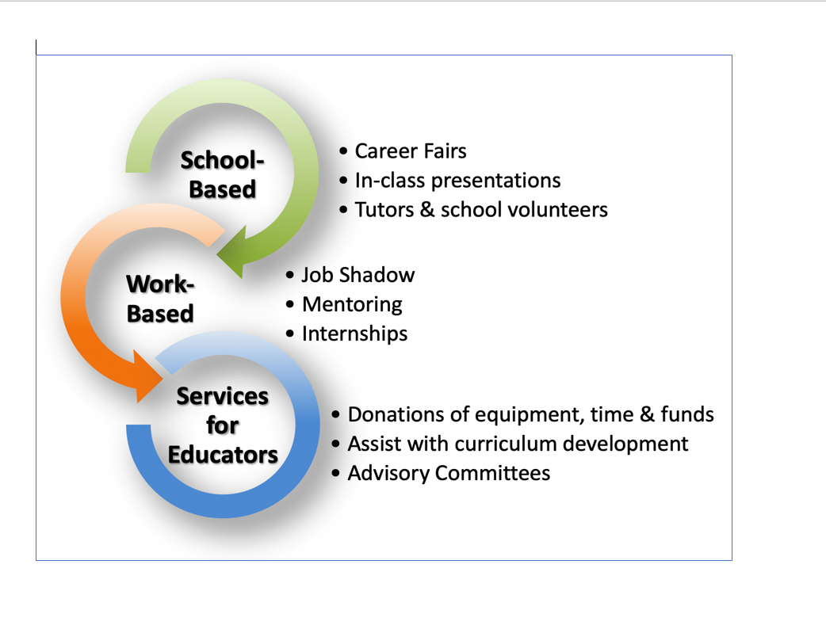

Slide 9
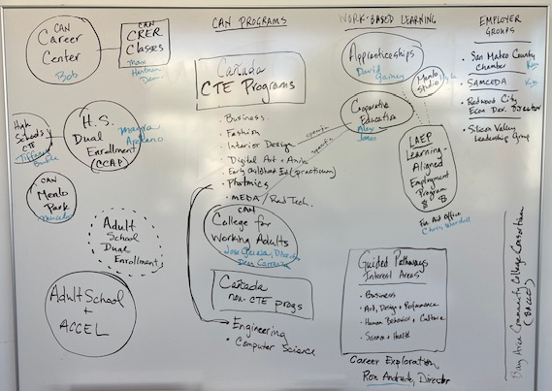
Review of “what is” - inventory and visual aides
Different outcomes for students?

Slide 10
Inventory of current employer engagement practices - responses

Slide 11
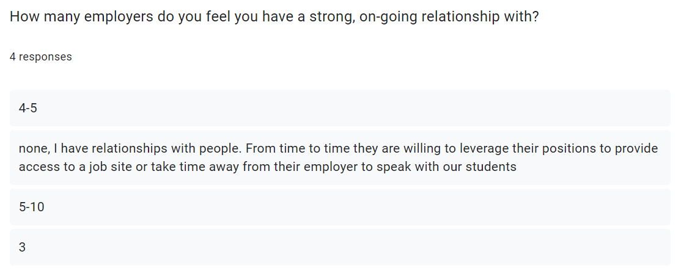

Slide 12
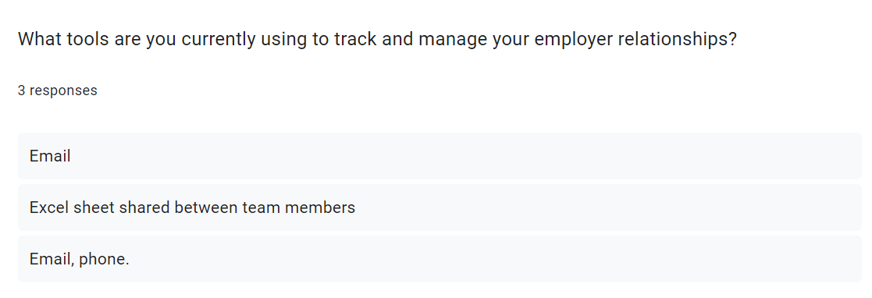

Slide 13
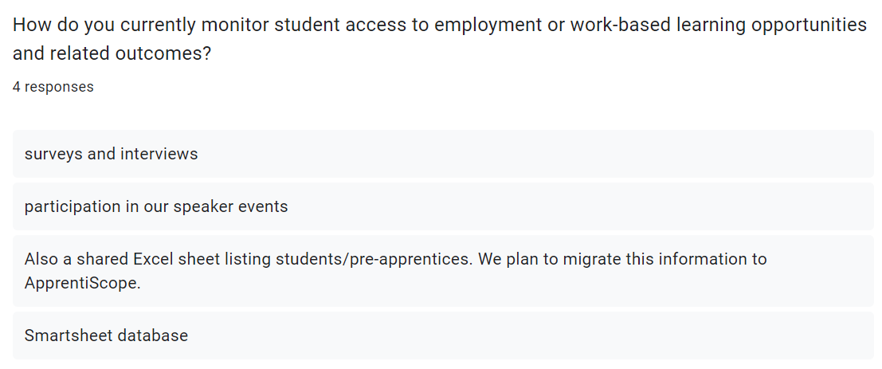

Slide 14
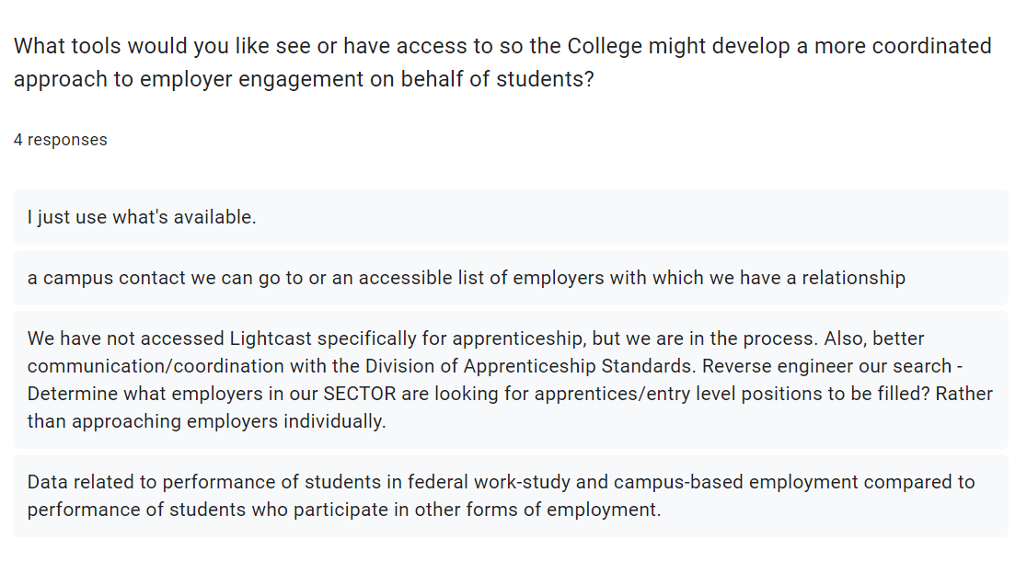

Slide 15
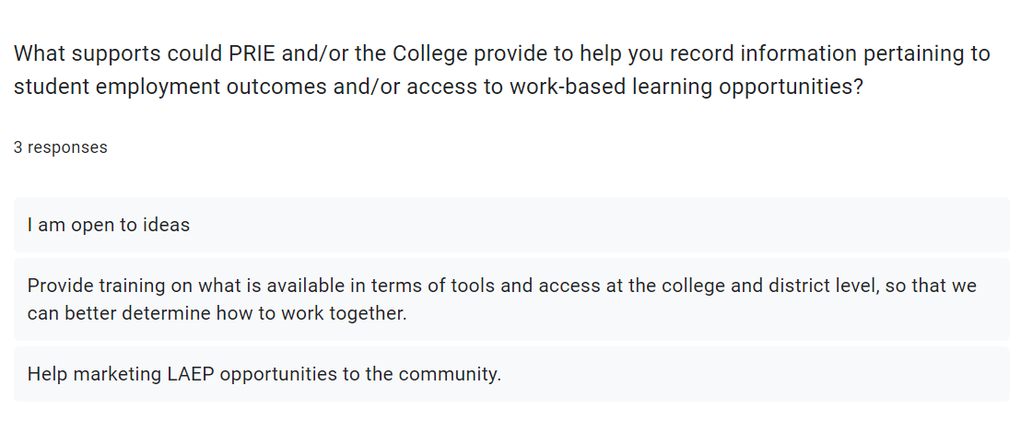

Slide 16
Discussion
How well is the current system is working for:
Work-based learning
Career exploration
Access to career opportunities
What do outcomes look like now for each of these?
How do we collect this information?
How do we share it?

Slide 17
Next Steps
Desired Outcomes: Recommend to PBC on how we can better serve our students (organizational changes, programmatic changes, communication). Consider the bigger picture and make recommendations for aligning our relationships with employers to improve and scale career opportunities for students.
Timing: Report recommendations to PBC before the end of the Fall 2023 term.

Slide 18
Conclusion
What did we do? Highlighted 1-2 things
What was the outcome?
What did we learn?
What will we do differently?

