Slide 1

New Accreditation Standards, Process, & Proposed Timeline
Presented to the Planning & Budgeting Council
(serving at the College’s Accreditation Oversight Committee) on October 18, 2023 by Karen Engel, Dean of PRIE and Accreditation Liaison Officer

Slide 2

Principles Guiding the New Standards
Align with Commission’s Eligibility Requirements, policies, and values
Reflect current norms and practices within US higher education
Focus on outcomes and improvement rather than processes
Reflect the diversity of ACCJC member institutions
Use clear language and minimize redundancies
Balance accountability and improvement
Emphasize equity and inclusion

Slide 3
Principles Guiding the New Standards
Align with Commission’s Eligibility Requirements, policies, and values
Reflect current norms and practices within US higher education
Focus on outcomes and improvement rather than processes
Reflect the diversity of ACCJC member institutions
Use clear language and minimize redundancies
Balance accountability and improvement
Emphasize equity and inclusion

Slide 4
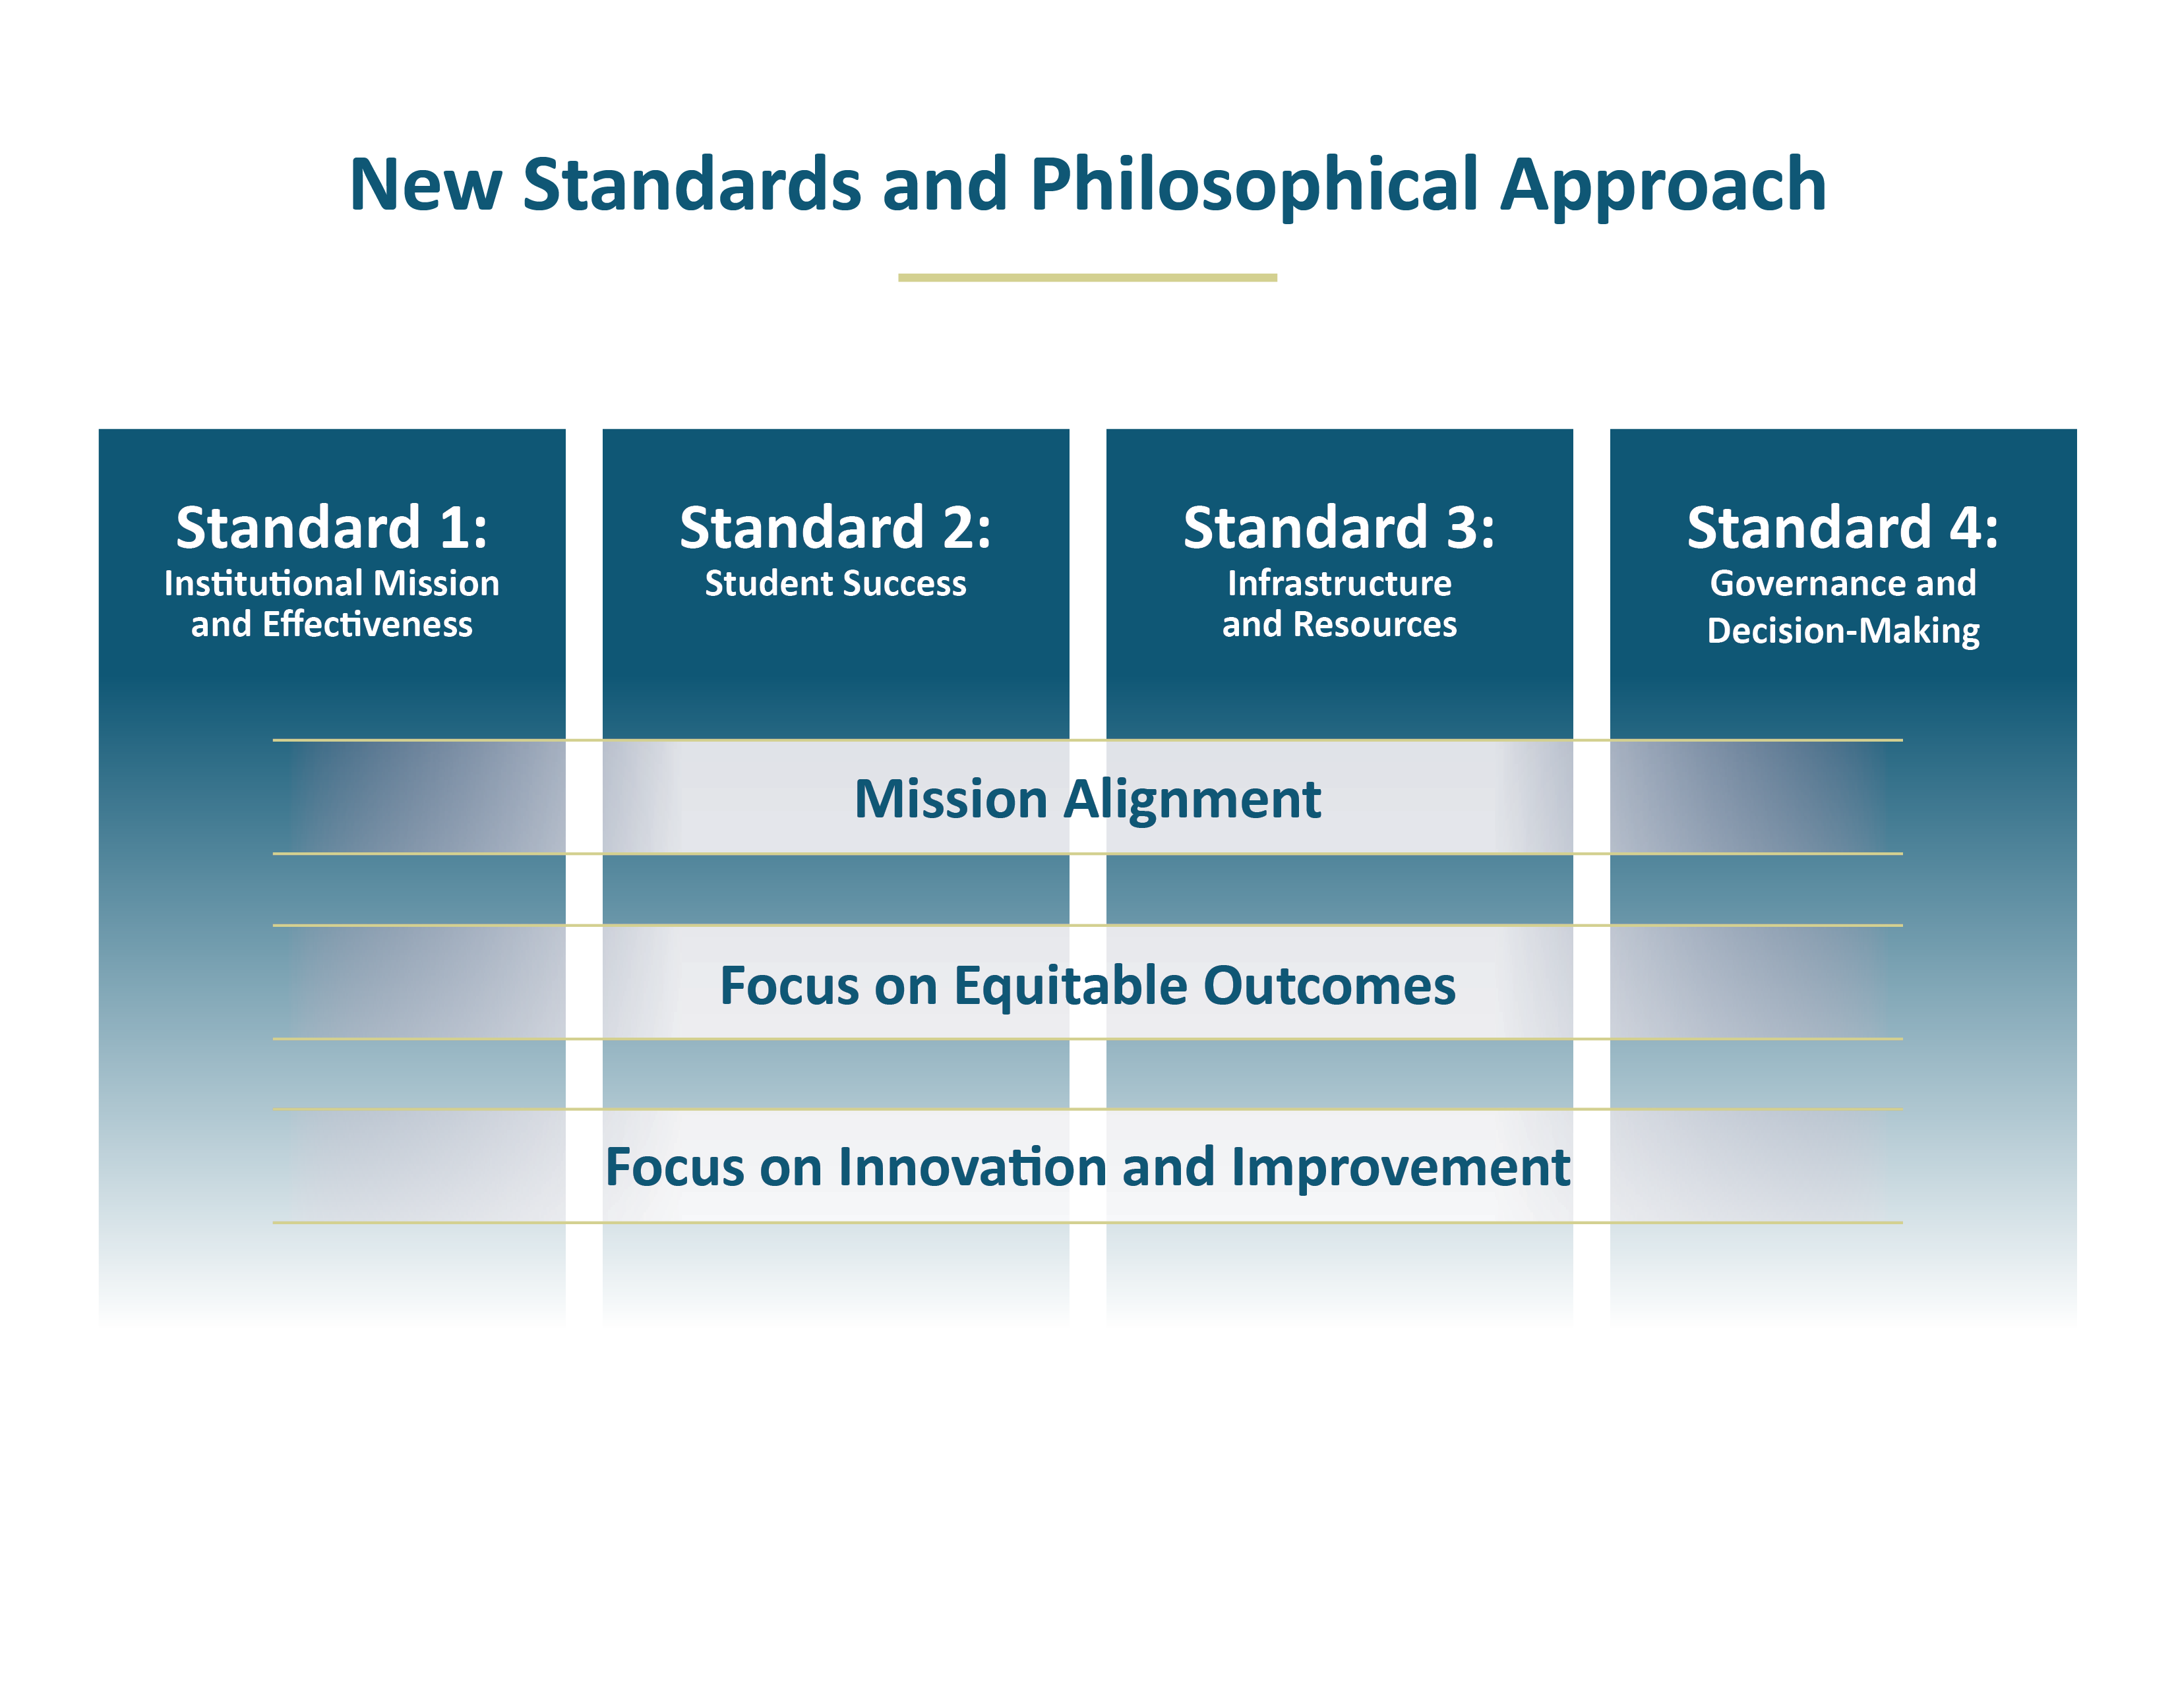

Slide 5
Overview of Major Changes in the Standards
FROM | → | TO
Repetitive and siloed | → | Streamlined and holistic
“do you have a process” | → | “what are the results, and how do you use them”
Narrative required for everything | → | Some documentation provided via checklist
120 Standards (127 for multi-college districts) | → | 30 Standards for all colleges

Slide 6
Overview of Major Changes in the Standards
FROM | → | TO
Repetitive and siloed | → | Streamlined and holistic
“do you have a process” | → | “what are the results, and how do you use them”
Narrative required for everything | → | Some documentation provided via checklist
120 Standards (127 for multi-college districts) | → | 30 Standards for all colleges

Slide 7
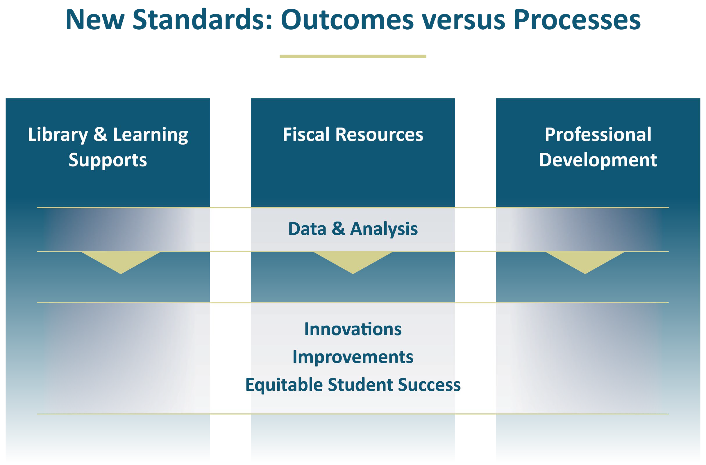

Slide 8


Slide 9
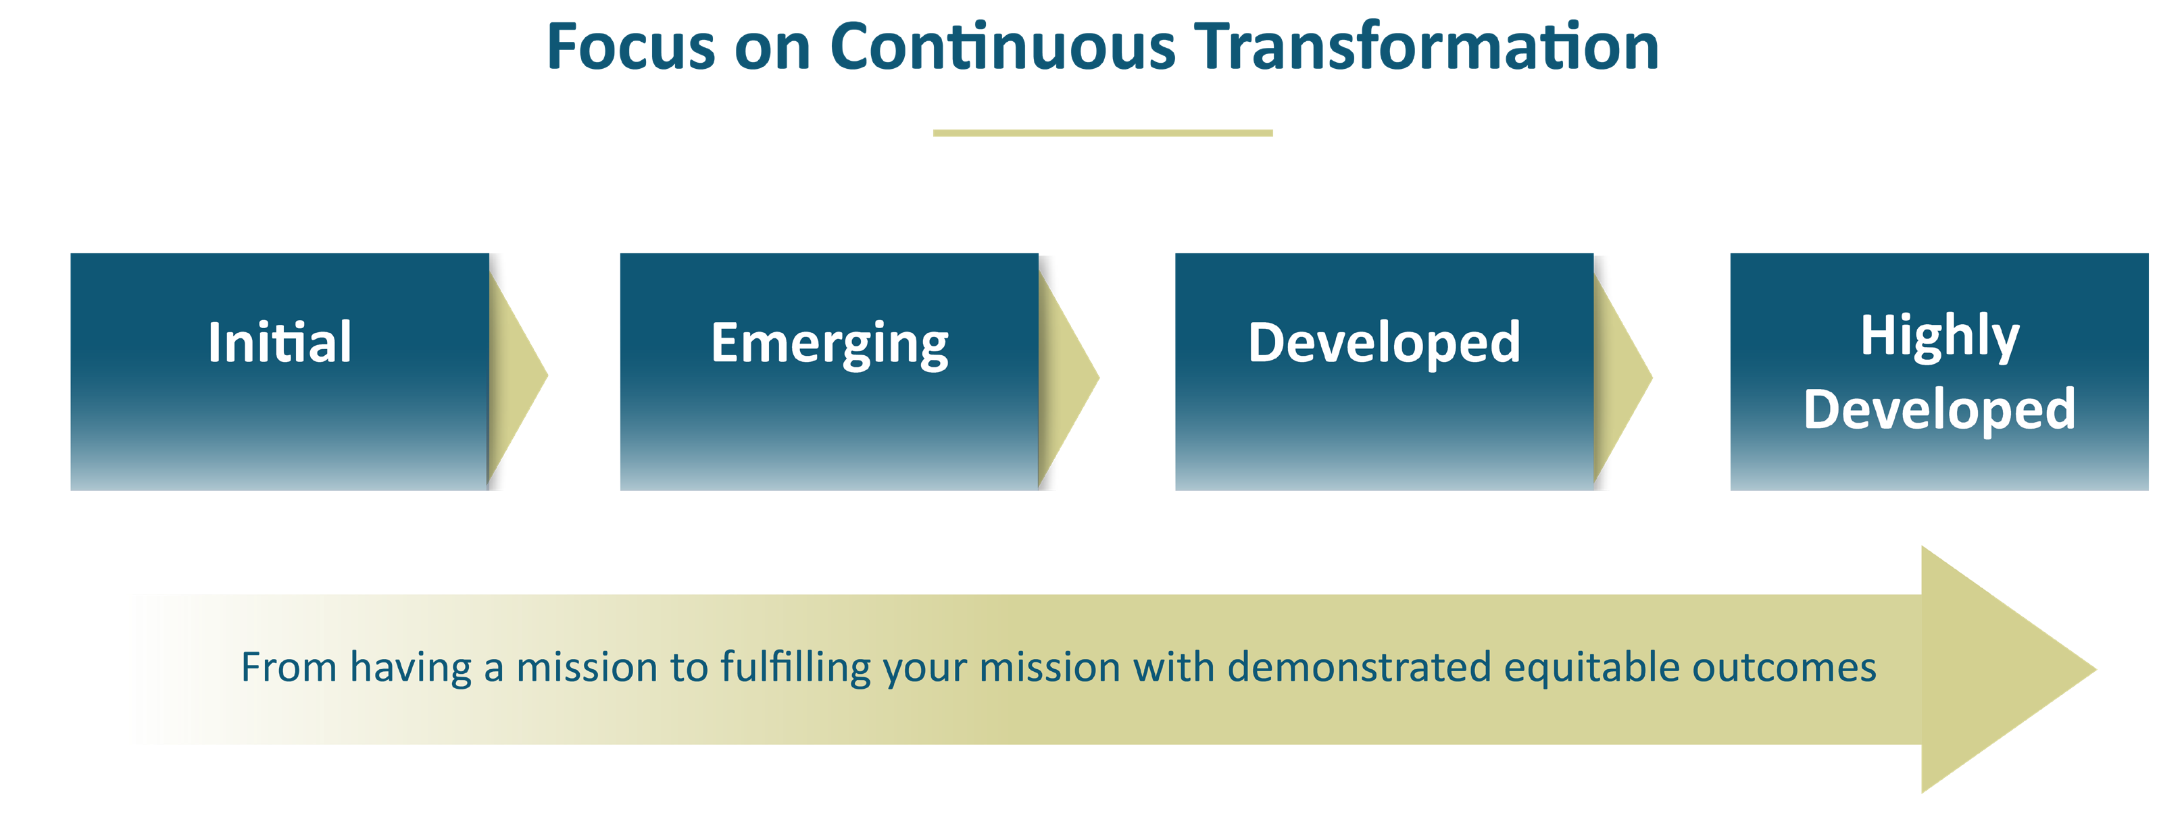

Slide 10
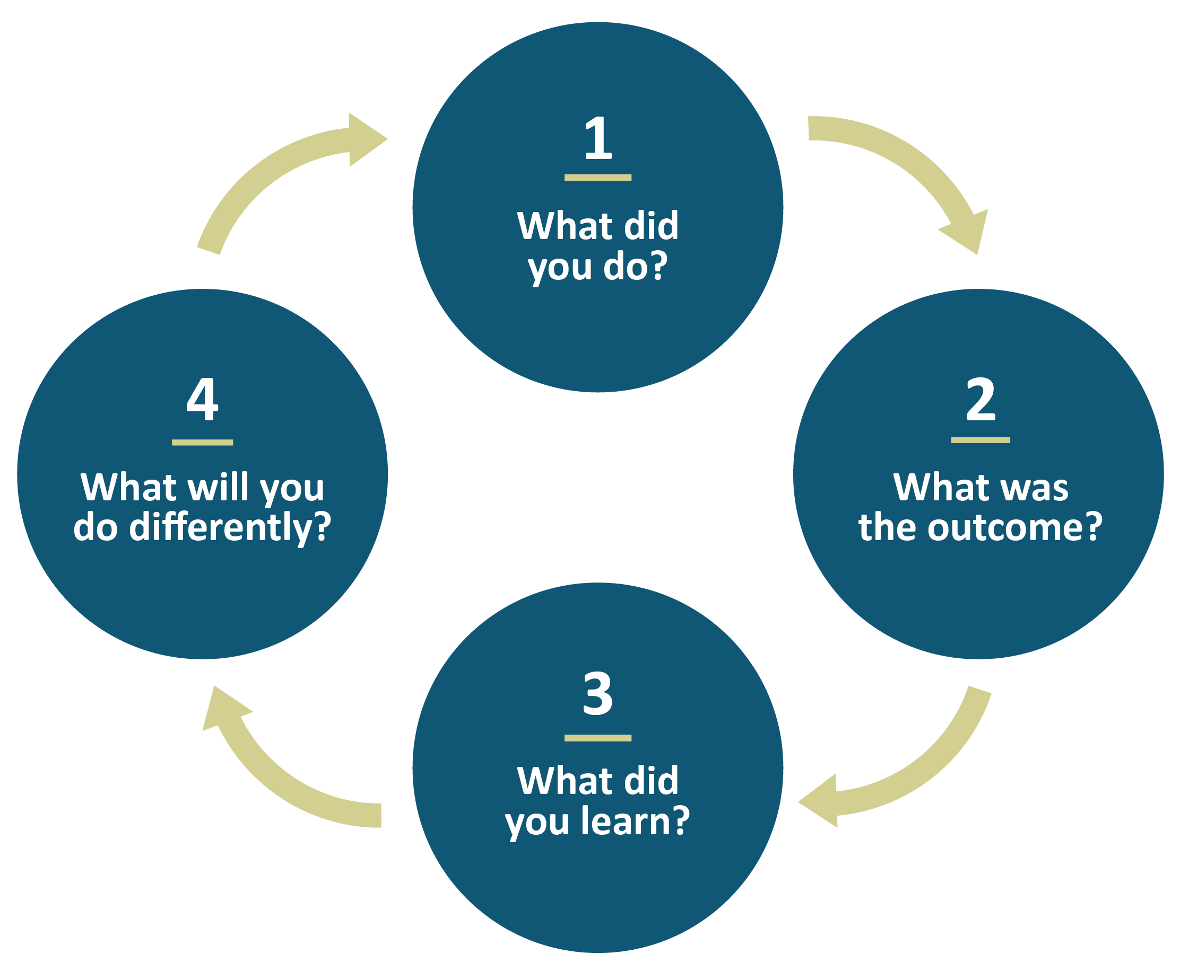

Forward-Looking Framework for Reflection

Slide 11
Evolving Expectations for Institutional Self-Evaluation Reports
New ISER Template (embedded instructions for each section)
Major Sections in the Self-Evaluation Report | Suggested Length
Forward to the Institutional Self-Evaluation | 1 page
A. Introduction: Institutional Context | 2-5 pages
B. Institutional Self-Evaluation of Alignment with the Accreditation Standards | 60-70 pages
C. Required Documentation | (no narratives)
D. Appendices: 1 – Verification of Catalog Requirements – Organizational Information – Additional Approved Locations (if applicable) | (no narratives)

Slide 12
Evolving Expectations for Institutional Self-Evaluation Reports
New ISER Template (embedded instructions for each section)
Major Sections in the Self-Evaluation Report | Suggested Length
Forward to the Institutional Self-Evaluation | 1 page
A. Introduction: Institutional Context | 2-5 pages
B. Institutional Self-Evaluation of Alignment with the Accreditation Standards | 60-70 pages
C. Required Documentation | (no narratives)
D. Appendices: 1 – Verification of Catalog Requirements – Organizational Information – Additional Approved Locations (if applicable) | (no narratives)

Slide 13
The first step in the institutional self-evaluation is to read and reflect on each Standard through the context of the institution’s mission.
During the reflection, it may be helpful to consider the following questions:
  • What does the institution do to align with the Standard?
  • What are the results of these actions? How effectively do the actions support equitable student success? How do you know?
  • What did the institution learn?
  • What will the institution do differently as it moves forward? How does that learning inform institutional plans for action, improvement, and/or innovation?

Slide 14
Proposed Initial Approach for Identifying Administrative, Senate, Council, and Committee Leads for Each Standard

Slide 15
Proposed Initial Approach for Identifying Administrative, Senate, Council, and Committee Leads for Each Standard

Slide 16
Proposed Initial Approach for Identifying Administrative, Senate, Council, and Committee Leads for Each Standard

Slide 17
Proposed Initial Approach for Identifying Administrative, Senate, Council, and Committee Leads for Each Standard

Slide 18
 | Initial Timeline for ISER Preparation: 2023-2025
Fall 2023 | PBC (Accreditation Oversight Committee) reviews new Standards and adopts overall timeline for the Self Evaluation process Administrative Leads for each Standard review new Standards and expectations for the Self-Evaluation Process with College Councils and Senates PBC forms an ISER Steering Committee that includes faculty, classified staff, and student leaders to join Administrative leads for each Section of the ISER to begin work in Spring/Fall 2024
Spring 2024 | Accreditation Steering Committee develops detailed plan for Report preparation. Administrative and Senate Leads begin identifying and collecting evidence. Administrative and Senate Leads identify any areas that need to be addressed (where evidence may be lacking) and presents these to PBC. PBC recommends how to address gaps in practice or evidence and Administrative and Senate leads work with Councils, Senates, and Committees to address them
Fall 2024 | Administrative, Senate, Council and Committee Leads address gaps in evidence, begin collecting and organizing evidence, and drafting brief narratives.
Spring 2025 | First Draft of ISER completed and all evidence gathered and organized.
Fall 2025 | Second and final Draft of ISER completed and submitted to BOT for approval. Final ISER Submitted to ACCJC by December, 2025.

Slide 19
Information and Resources
Cañada Accreditation Website
ACCJC Resources Website
Accreditation Manual (new as of 2023)

