Slide 1

Program Review
Position Request Presentation
Position: Library Support Specialist from 11 months to 12 months
Requested by: ASLT - Library

Slide 2
History
Online Transition (March 2020):
  Swift transition to online learning due to Shelter-In-Place (SIP) directive.
  Cataloging of dispersed campus technology into Alma platform initiated.
Student Technology Shortage (Months into SIP):
  Shortage identified, prompting urgent acquisition and cataloging.
  Focus on historically underserved students with a substantial waiting list.
Library Support Specialists (LSS) entrusted with cataloging and maintaining the Alma inventory.
  Specialized skill set of LSS crucial for meticulous input of metadata, including location codes, device types, and serial numbers.
Ongoing technology responsibilities
  Continuing growth of Library technology collections
  Deployment/retrieval of technology
Ongoing commitment of LSS highlights their crucial role in maintaining a centralized technology inventory.
Request for additional funding to support LSS in better serving historically underserved students and addressing the digital divide.
ADD collaboration with other departments such as EOPS and the DRC and BDW.

Slide 3
Justification
Not a new position. This is an extension of an already
established 11- month position.
Will add only 22 additional workdays per fiscal year.
Institutional breaks are crucial times for progression and
completion of various on-going projects supported by SS.
Allow for development and maintenance of the Textbook Reserves
Collection to further support Faculty and underserved students.
Textbook Affordability Subcommittee (OER/ZTC)
Post-pandemic has created an extensive need for
technology management.

Slide 4
Justification
In-session workdays require continuous interaction with students and the public; insufficient time to devote to non-public facing duties and on-going projects.
Working when classes are not in session supports equitable access to technology and other learning resources for our students.
120 new Lenovo Chromebooks were added to our technology collection at the start of Fall 2023.
New and ongoing collaborations with other departments to catalog, process, deploy/ retrieve technology owned by other departments (DRC, EOPS, INTD) to provide easier and equitable access to students in need of learning technologies.
We only have one 12-month Library Support Specialist and two 11-month Library Support Specialists.

Slide 5
By the Numbers
Circulation of Books and Reserves
Year | Books | Reserves
Aug 2020 - Jul 2021 | 326 | 102
Aug 2021 - Jul 2022 | 4173 | 465
Aug 2022 - Jul 2023 | 5689 | 919

Slide 6
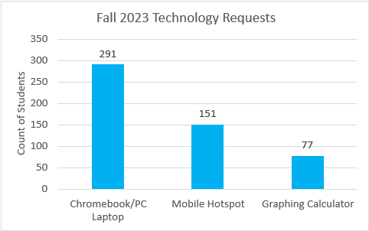
By the Numbers
Technology Added by Library Support Specialists
Year | Technology Added
Aug 2020 - Jul 2021 | 333
Aug 2021 - Jul 2022 | 273
Aug 2022 - Jul 2023 | 430
Circulation for Technology
Year | Chromebooks/Dells | WiFi Hot Spots
Aug 2020 - Jul 2021 | 507 | 761
Aug 2021 - Jul 2022 | 549 | 1010
Aug 2022 - Jul 2023 | 1073 | 1805

Slide 7
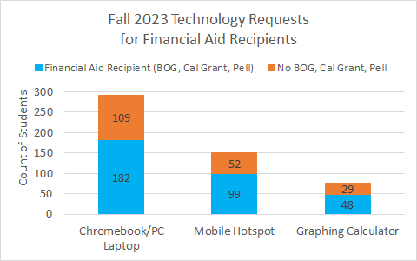
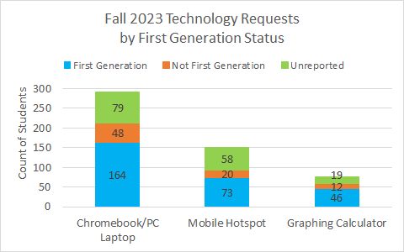
Equity and Technology Loans

Slide 8
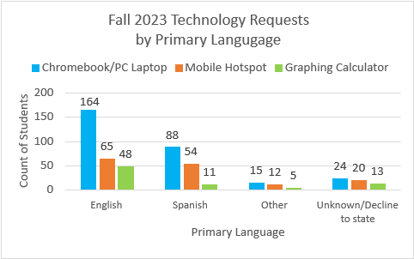
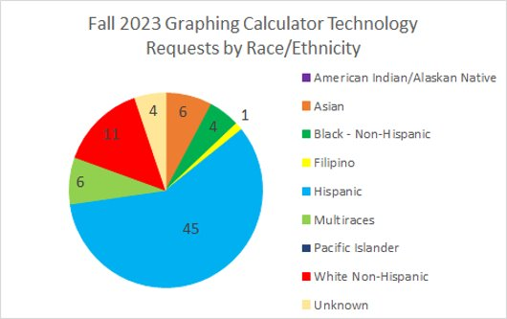
Equity and Technology Loans

Slide 9
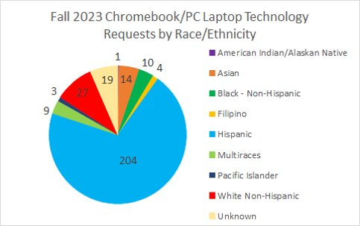
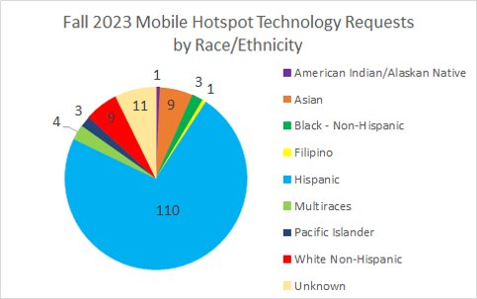
Equity and Technology Loans

Slide 10
Conclusion:
We are requesting just a 1-month extension of an 11-month position
22 additional days of work per fiscal year to:
Develop and expand student loan technology collection
Assist our Cataloging LSS (12-month position)
Develop and maintain textbook reserves collection
OER and ZTC collaboration and implementation
Increase student equity and service to the college as a whole
Troubleshooting and Outreach

