Slide 1

Program Review
New Position Request Presentation
Position: EOPS/NextUp/Promise Counselor
Requested by: Mayra Arellano & Lorraine Barrales-Ramirez
Notes:
Mayra and Lorraine

Slide 2

San Mateo County Community College District's Promise Scholars Program (PSP) helps first time, full time students earn certificates and associates degrees within two to three years by providing comprehensive financial, counseling, and academic supports. Students receive dedicated academic counseling, personalized career development, tutoring, enrollment fee waivers, textbook assistance, and transportation assistance to support their enrollment, completion, and transfer/career goals.
-
Mission – Promise
Notes:
Mayra

Slide 3


Mission - EOPS
Extended Opportunity Programs and Services (EOPS) was the first social justice program at the community college level to address the issues of access, equity, and completion at the state level; acting as a gateway for financial and social mobility. EOPS provides a network of supportive counselors and dedicated staff, in addition to financial, and other various retention assistance so that students stay focused on their educational path while at Cañada College. Some of the services students receive are academic counseling, a book voucher, educational supplies, transportation and food assistance, and priority registration.
Notes:
Lorraine

Slide 4



Mission
NextUp
The NextUp Program, an integral component of the existing EOPS Program, which aims to enhance the capacity of community college districts in supporting the academic success, health, and well-being of current and former foster youth. Specifically designed for individuals whose dependency was established or continued by the court on or after their 13th birthday, NextUp provides comprehensive assistance, including financial support, general counseling, and additional student services. The program fosters success through a coordinated approach, engaging both internal and external community partnerships to identify and address barriers, including health and well-being, for the academic achievement of current and former foster youth enrolled at community colleges.
Notes:
Lorraine

Slide 5

NextUp Update & Information
Last year the State approved for $30M in additional funds to expand NextUp programs to all Community Colleges under EOPS.
NextUp is now an integral part of the EOPS categorical funding.
The staffing model for NextUp should be significantly more robust than for most other campus-based programs. The level of interaction necessary for foster youth to be successful is, on average, much greater than for other students, including for other EOPS students
It is critical that staff have experience working with this population or who have experience working with other individuals who require a high-touch, trauma-informed, wraparound system of support.
Notes:
Lorraine

Slide 6
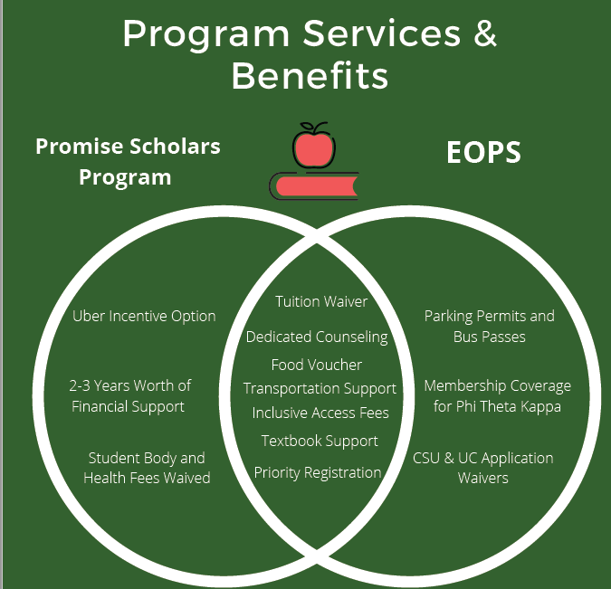

Promise and EOPS Partnership
Notes:
mayra

Slide 7
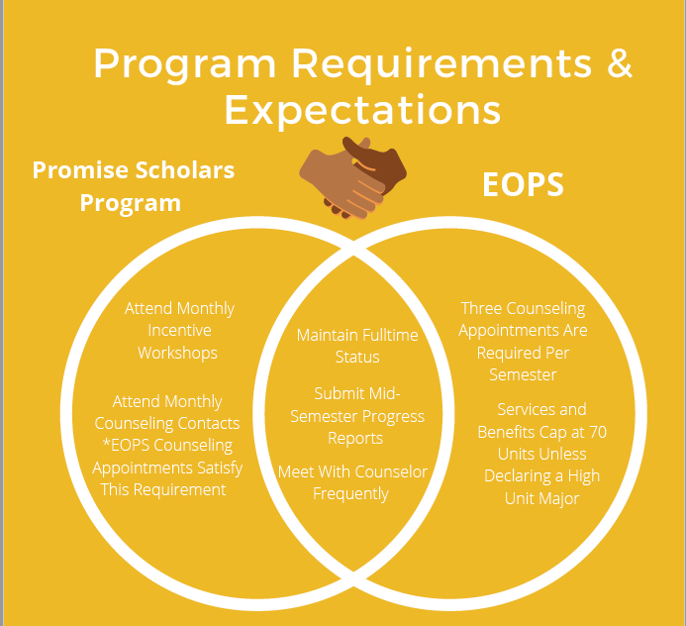
Promise and EOPS Partnership
Notes:
Lorraine

Slide 8
Shared Students: EOPS/Promise
67 students
50 Students
42 Students
Fall 2019
Fall 2021
Fall 2022
Spring 2021
Spring 2022
Fall 2023
56 Students
55 Students
66 Students
Notes:
Mayra

Slide 9

EOPS/NextUp/Promise Counselor
Personnel Request
Duties:
  Provide consistent student follow-up
  Teach a CRER (cohort) class
  Organize Summer Bridge Program
  Facilitate Workshops/Group Counseling Sessions
  Provide Career Exploration
  Participate and contribute to the anti-racist and social justice initiatives on campus
  Support our Foster Youth and Homeless Students
  Be a bridge for students in both EOPS & PSP
Notes:
Lorraine

Slide 10

SMCCCD PSP Expansion
 | 2019-20 (Actuals) | 2020-21 (Actuals) | 2021-22 (Actuals) | 2022-23 (Actuals) | 2022-23 (Actuals) | 2024-2025 (Target)
Skyline College | 756 | 738 | 642 | 754 | 1,018 | 1,500
College of San Mateo | 737 | 692 | 740 | 928 | 930 | 1,500
Cañada College | 497 | 464 | 387 | 465 | 617 | 1,000
# SMCCCD Promise Students | 1,986 | 1,876 | 1,769 | 2,500 | 2,565 | 4,000
Notes:
Mayra

Slide 11

Cañada College EOPS Expansion
 | 2018-19 (Actuals) | 2019-20 (Actuals) | 2020-21 (Actuals) | 2021-22 (Actuals) | 2022-23 (Actuals) | 2023-24 (Target)
EOPS | 418 | 355 | 253 | 219 | 201 | 350
Notes:
Lorraine – from a CCPG report this semester there were potentially 979 students who were not already in EOPS. Each semester that number can fluctuate between 950-1400 students.

Slide 12


Cañada College FYSI Expansion
 | 2019-20 (Actuals) | 2020-21 (Actuals) | 2021-22 (Actuals) | 2022-23 (Actuals) | 2023-24 (Target)
FYSI/NextUp | 2 | 3 | 7 | 20/4 | 20/20
FY Identified at Cañada | 77 | 32 | 37 | 31 | 53
Notes:
Lorraine

Slide 13
How does this position request further the College’s ability to achieve its strategic goals & immediate priorities?
EMP COLLEGE GOAL #1 Student Access, Success, and Completion
Cañada College ensures student access to relevant and transformative student services and instructional programs that are inclusive, diverse, equitable, and anti-racist. As an institution, Cañada contributes to the financial stability of students to empower them to pursue personal, academic, professional, and civic goals. Cañada College continuously assesses processes and removes barriers to student access, success, and completion.
1.16 -- Create a campus culture that expects and supports students’ completion of their educational goals within three years using tactics such as: (1) scheduling classes according to student interest and demand (informed by Student Education Plan (SEP) data; (2) offering more course-taking opportunities during the summer; (3) monitoring student progress more closely (via Success Teams, the Retention Specialist Community of Practice, and the Transfer Center.
1.11 -- Complete the college redesign process according to the essential practices of Guided Pathways and ensure that all students are connected to and feel supported by their Interest Area and Success Team and, if applicable, their special program (e.g., Promise, EOPS, TRIO SSS, Puente, Umoja, etc.).
1.14 -- Strengthen and scale student affinity programs and other student support programs such as Umoja, Puente, EOPS, and TRIO SSS and create strong ties and coordination between them and the Interest Area Success Teams such that BIPOC and LGBTQ+ students are well supported to complete their educational journeys at Cañada within 3 years.
Notes:
Mayra – Brief Statement for slides 12-17

Slide 14
How does this position request further the College’s ability to achieve its strategic goals & immediate priorities?
Promise and EOPS counselors have experience serving first-time, full-time college students with an educational goal to graduate with a degree or certificate, or transfer to a 4-year university.
The demographic of our cohort reflects our high need students within Cañada College’s service area.
To increase the opportunity gap among the underserved population in our community, EOPS, NextUp, and PSP prioritize low-income, first-generation, housing insecure, and AB540 students.
The PSP and EOPS/NextUp are committed to equitable practices by removing systematic and financial barriers to increase student completion and success. To continue our equitable, accessible, student-centered work through an anti-racist lens, we require full-time dedicated counselors to maintain the integrity and permanency of our programs.
Notes:
Mayra

Slide 15
How does this position request further the College’s ability to achieve its strategic goals & immediate priorities?
EMP COLLEGE GOAL #2 Equity-Minded and Antiracist College Culture
Cañada College transforms its culture to be equity-minded and antiracist. Our teaching, learning, and services create a sense of belonging among all community members so they are able to recognize that their unique selves are valued, express themselves fully, and thrive. Our educational practices reflect the fundamental importance of individualized learning experiences, the shared building of knowledge, and promoting social justice at Cañada College.
2.6 -- Revise and improve faculty and staff hiring practices that recognize both traditional and nontraditional experiences and qualifications to ensure the hiring of a diverse pool of faculty and staff applicants.
Notes:
Mayra

Slide 16
How does this position request further the College’s ability to achieve its strategic goals & immediate priorities?
EOPS requires that counselors have the following:
  completed a minimum of nine-semester units of college course work predominantly relating to ethnic minorities or persons handicapped by language, social or economic disadvantages; OR six-semester units or equivalent of a college-level counseling practicum or counseling fieldwork courses in a community college EOPS program, or in a program dealing predominantly with ethnic minorities or persons handicapped by language, social or economic disadvantages; and,
  have two years of occupational experience in work relating to ethnic minorities or persons handicapped by language, social or economic disadvantages.
The purpose of NextUp/FYSI is to create a network of support that will meet the academic, social, emotional, and financial needs of college-bound students exiting the foster care system. It is crucial that faculty and staff working with NextUp/FYSI students are knowledgeable of the intrinsic issues they face and understand how to support them.
The Promise Scholars Program (PSP) contributes to anti-racism at Cañada College through programming, collaboration, data-driven inquiry, and staff professional development. In addition to program collaboration, Promise engages in data inquiry and reporting.
Notes:
Mayra

Slide 17
How does this position request further the College’s ability to achieve its strategic goals & immediate priorities?
EMP COLLEGE GOAL #3 Community Connections
Cañada College establishes equity-minded partnerships with other educational institutions, employers, governments, and community-based organizations that result in seamless pathways for high school students transitioning to college, college students transitioning to university, and all community members pursuing career, and lifelong educational opportunities.
3.3 -- Utilize relevant social media and other marketing platforms to reach community members in the formats and virtual environments in which they exist. Ensure College websites are up-to-date, accurate, informative, and speak to community members in a language that is welcoming and inclusive.
3.2 -- Transform where we share what Cañada has to offer by identifying and reaching new outreach audiences that help strengthen our ties to BIPOC communities (particularly those communities our recruitment maps indicate might be underserved, such as North Fair Oaks, Belle Haven, and East Palo Alto).Recruit more BIPOC students, including more students who identify as Black / African American.
3.8 -- Strengthen transfer support services by, (1) building University pathways and expanding the University Center, (2) increasing by 35% the number of Cañada College transfer-seeking students who achieve transfer readiness and the number of students who apply to a 4-year University ­­­between 2022 and 2027 (adjusted for enrollment fluctuations) and, (3) reduce the transfer equity gap for low-income, first generation, and Black, Indigenous, and People of Color (BIPOC) students.
Notes:
Mayra

Slide 18
How does this position request further the College’s ability to achieve its strategic goals & immediate priorities?
Collaboration is one of the strongest keys to our success. Every year, our cohort consists of shared students among student services across campus, such as Puente, STEM, TRIO, and Athletics. However, the largest shared student population is with PSP and EOPS. Currently, two of our adjunct counselors are shared EOPS/Promise counselor. To strengthen this partnership, the hiring of a full-time EOPS/NextUp/Promise shared counselor will be able to serve our highest-need students, including former foster youth, low-income, and first-generation students. We have found that students participating in both programs have higher engagement and persistence rates during their time in college due to the increase in wrap-around services.
EOPS has an Advisory Board made up of on-campus and off-campus partners, including programs from SUHSD, Sequoia Adult School, CSUs, and community agencies.
The In Resources & Opportunities for Success & Excellence (ROSE) Committee is a collaboration with NextUp/FYSI, San Mateo County, and the Foster & Kinship Care Education Programs that has created a network of support.
One of EOPS/NextUp and PSP goals is to increase transfer rates among low-income, first generation, and Black, Indigenous, and People of Color (BIPOC) students.
Notes:
Mayra

Slide 19
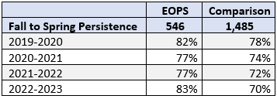
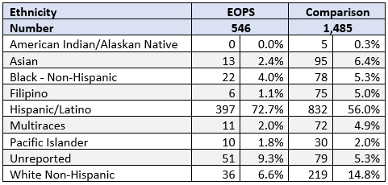
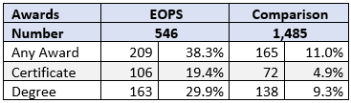
EOPS Outcomes Comparison Report
Key Findings from a Comparison Report of EOPS Students and
Potentially EOPS Eligible Students, Fall 2019 - Spring 2023:
Overwhelmingly 73% of EOPS students identify as Latinx.
EOPS students perform better academically with higher Fall to Spring persistence.
EOPS students are far more likely to attain a degree or certificate than the comparison group.
Notes:
Lorraine

Slide 20

Current Staffing - Counseling
EOPS
  2.0 – 1 full-time and the remaining time divided by four counselors.
EOPS/PSP
  1.0 – 2 adjunct
PSP
  3.0 – 2 full-time and 3 adjunct
NextUp/FYSI
  0.5- 1 adjunct
Notes:
Mayra

Slide 21
Requested Allocation
SALARY PROPOSAL FROM FUND 1
Proposed Budget | FTE | Projected Salary Step 5, Grade 4 | Projected Benefits 41.03% | Total Projected Budget
EOPS/NextUp/PSP Counselor | 1 | $98,340 | $40,353 | $138,693
NextUp Funding | 20% |  |  | $27,739
Fund 1 Request | 80% |  |  | $110,954
Fund 1 allocation can be used towards the EOPS required match.
New NextUp funding requires staffing to support FY students under EOPS.
Notes:
Lorraine

Slide 22

Thank You!
Any Questions?
Notes:
Both

