Slide 1
Request for Instructional Aide II
Part-time | Permanent
EMP Goals 1 & 2
EMP 4.8

Slide 2
EDUCATION & HUMAN DEVELOPMENT
Early Childhood Education
Early Childhood Education Certificate of Achievement
Inclusion Support Certificate of Achievement
Multilingual Learners Teacher Certificate of Achievement (pending)
AS-T in Early Childhood Education
AA-T in Child and Adolescent Development
Education
Youth and After School Certificate of Achievement (in revision)
AA-T in Elementary Education
Human Services
Human Services Paraprofessional Certificate of Achievement (pending)
AA-T in Social Work and Human Services

Slide 3
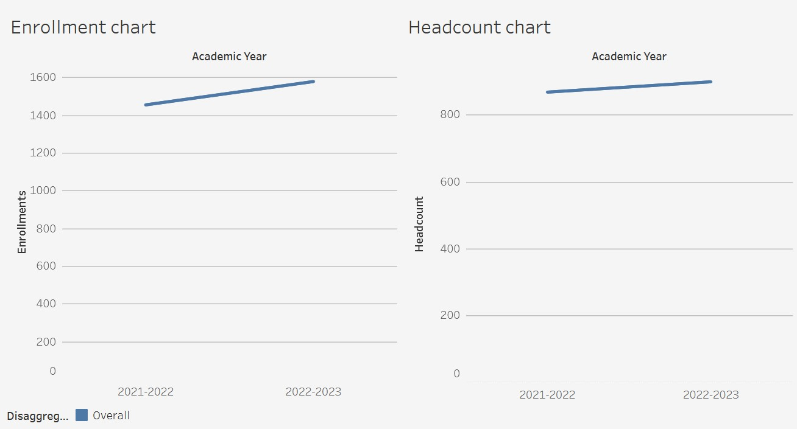
ENROLLMENT

Slide 4
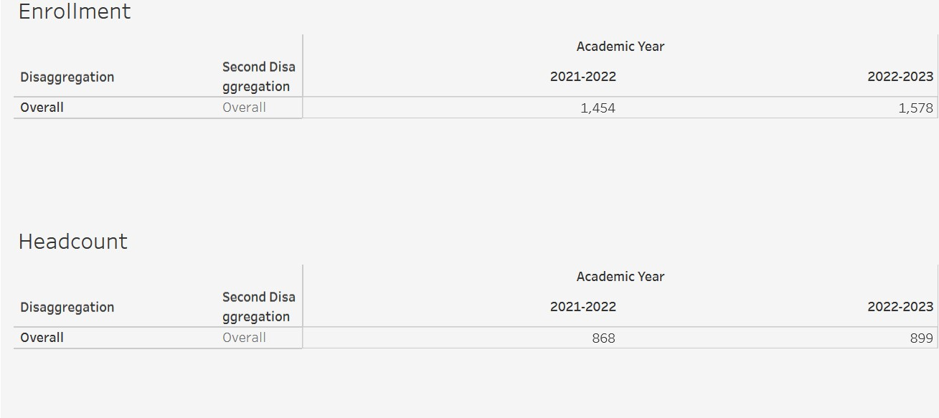
ENROLLMENT

Slide 5
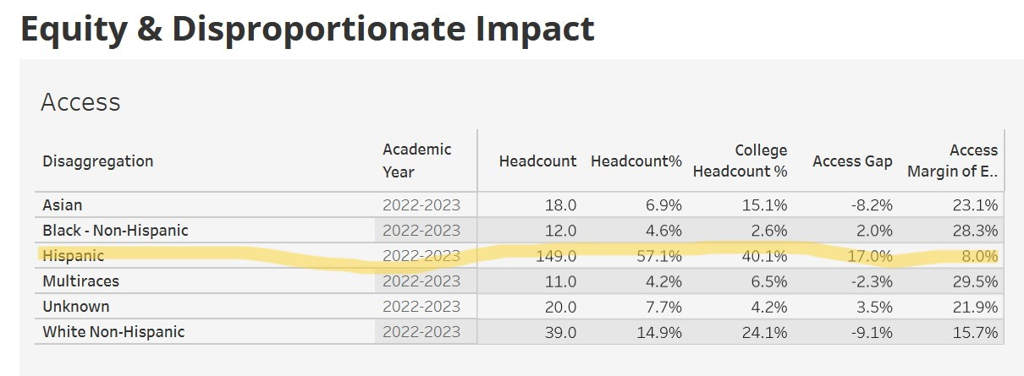
EQUITY

Slide 6
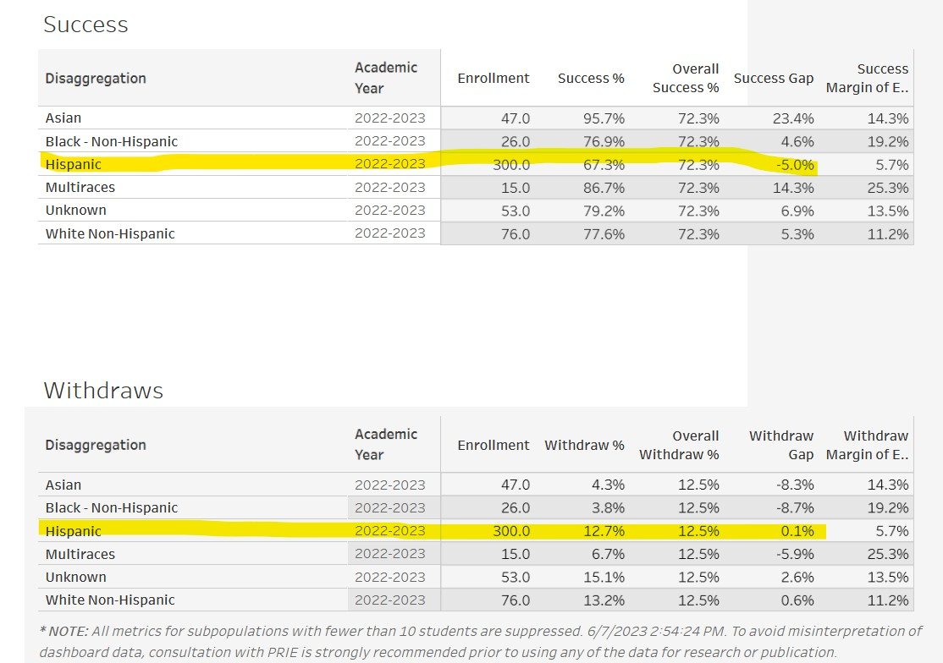
EQUITY

Slide 7
2022-2023 PILOTS
Fall 2022 | Embedded Tutor in collaboration with Learning Center
Embedded in one course
Assistance available via office hours at Learning Center
Subject-matter and writing support
English only
Spring 2023 | Student Assistant with support from Strong Workforce
Embedded in two courses
Assistance available via appointment w/supervision of EHD faculty/staff
Subject-matter and translation support
Spanish-English
Fall 2023 | Student Assistants with support from Strong Workforce
Assistance via appointments w/supervision from EHD faculty/staff
Subject-matter and translation support
Spanish-English

Slide 8
GRADUATE SURVEY ILO ASSMNT SPRING 2023
During my time at Cañada College, I have improved my ability to convey my ideas confidently, both orally and in writing.
Program of Study | Median Ranking
Early Childhood | 100
Interdisciplinary Studies | 93
Business, Accounting, Economics | 83
Social Sciences | 78
Interior Design | 70
STEM | 52

Slide 9
CONCLUSIONS
As part of an HSI, the Education and Human Development Department serves a significant number of native Spanish-speaking English Language Learners.
Observations from faculty, staff, and students of pilot supports (i.e., embedded tutor, student assistants) suggest that translation support that clarify subject matter and course processes are the most effective in helping students access content, feel more included and valued in our classes, persist in their classes, as well as perceive their education as meaningful and beneficial.
Our bilingual assistants/tutors were the ones most often approached by students for support, in comparison to assistants/tutors who were English-only speakers.
Equitable access to subject-matter content improved with translation support for clarification, supervised tutoring that was culturally and linguistically respectful and appropriate.
REQUEST: Permanent part-time Instructional Aide II with a general background in Child Development/Education or equivalent experience, to assist with clarification of subject matter content and academic processes; supervised tutoring; support in connecting with other campus resources; other duties listed under the position such as attending meetings, assisting with curriculum preparation and organization of materials, supporting faculty with technology-enhanced courses, test proctoring when needed, and supervising student assistants.

Slide 10
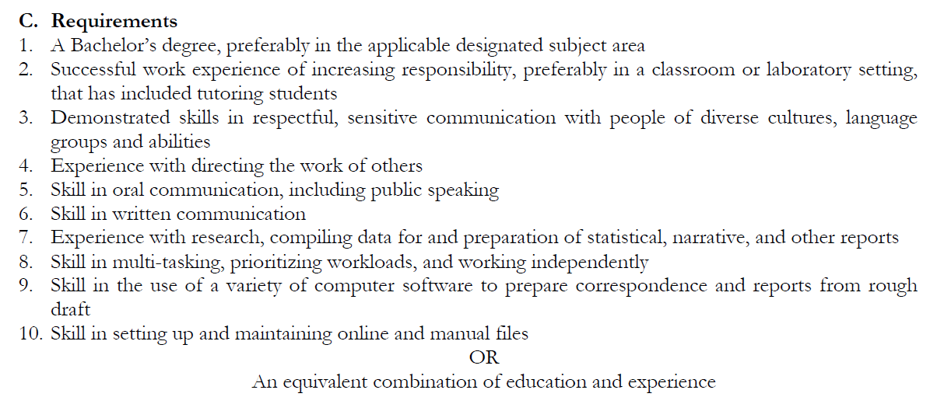
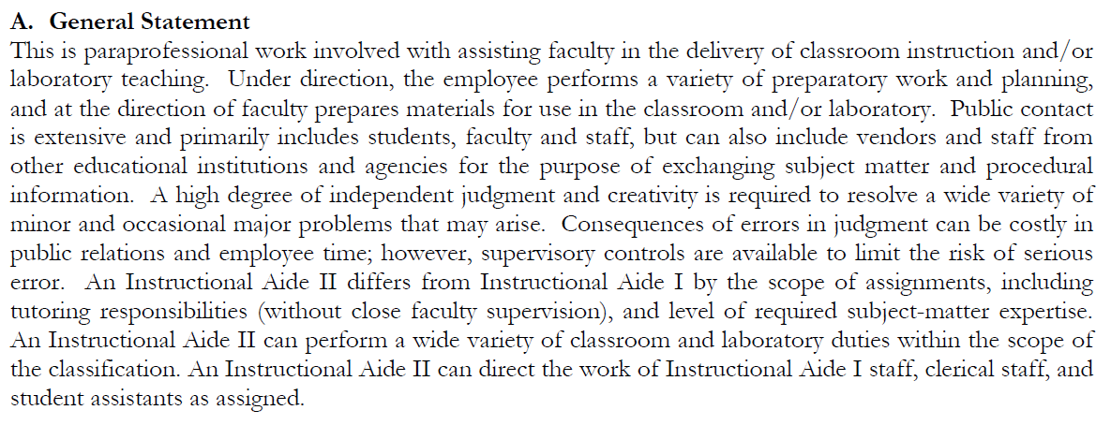
INSTRUCTIONAL AIDE II
From SMCCCD General Position Description:
https://acrobat.adobe.com/link/review?uri=urn:aaid:scds:US:02ad719d-bec1-3692-bb9a-9b0b8a1ac131

Slide 11
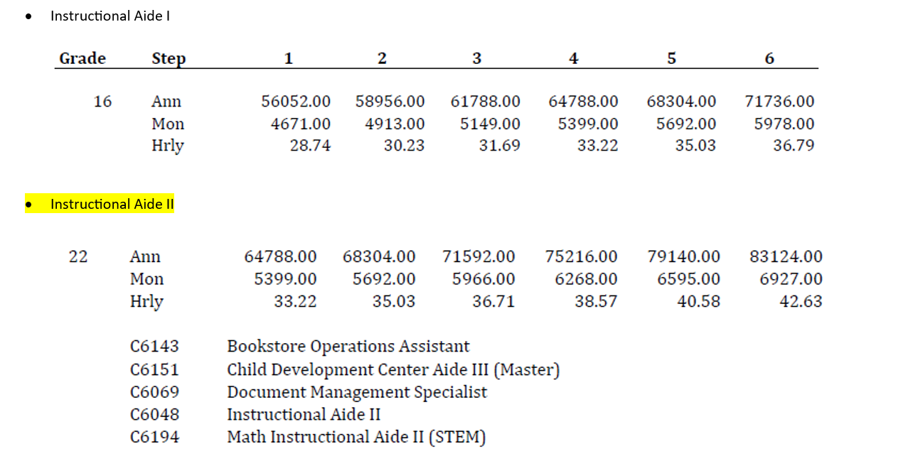
Funding: Strong Workforce, Perkins
SALARY SCHEDULE
Full-time | We are requesting part-time permanent. Will work with dean to determine %FT for part time Instructional Aide II

