Slide 1
Annual (operational) Plan for 2020-21
Proposed to PBC as of September 2, 2020

Slide 2
The College Annual Plan
Sets forth the activities to be implemented in one year to support the achievement of the five-year goals articulated in the Education Master Plan, which are in support of achieving the College Mission.
Is a synthesis of objectives, strategic initiatives, and activities of other college plans, grant deliverables, and recent mandates from the State Chancellor’s Office.

Slide 3
Education Master Plan: 2017-2022
Year 1
2017-18
Year 2
2018-19
Year 3
2019-20
Year 4
2020-21
Year 5
2021-22
Strategic Enrollment Planning Strategic Enrollment Management Plan: 2020-23
Year 1
2020-21
Year 2
2021-22
Year 3
2022-23
College Committee Planning: 2020-2023
Align 3-year planning as appropriate per committee
Annual Strategic Plan
(operational)
Annual Strategic Plan
(operational)
Annual Strategic Plan
(operational)
Where we are now

Slide 4
FOCUS THIS YEAR:
Prioritize support for students, faculty and staff during COVID-19 and remote campus operations
Apply guiding principles (or a framework) related to fulfilling the campus-wide commitment to becoming an anti-racist institution and interrogating the college mission of “ensuring that all students have equitable opportunities to achieve their transfer, career education, and lifelong learning educational goals” and determining how it may need to shift in order for Canada to become an anti-racist institution.

Slide 5
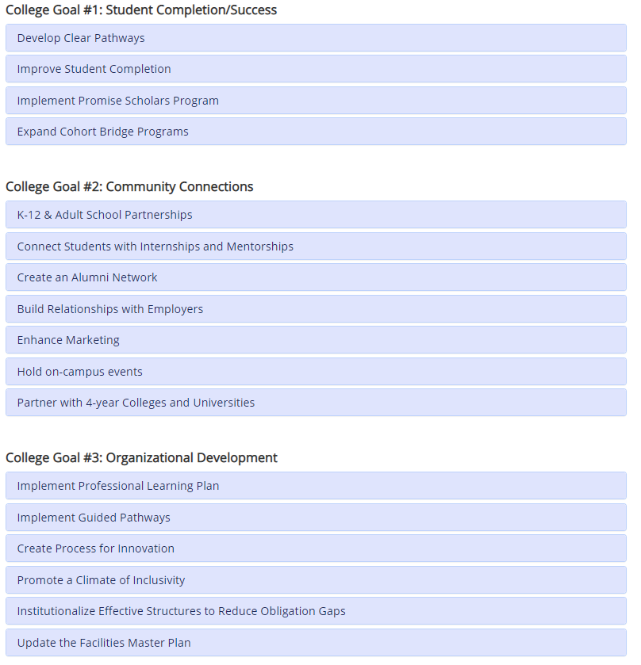
17 strategic initiatives
Education Master Plan (EMP)
Top 6
2020-21
Strategic Priorities
Considering COVID-19

Slide 6
Origin | Description | Responsible Administrator | Committee/Group
Leadership Retreat Objective | Prioritize online student success with an emphasis on interpersonal connections | VPI Robinson and VPSS Pérez | College Cabinet
Leadership Retreat Strategies (2020-21) | Integrate Student Success Teams (from Guided Pathways) into online learning environment | VPSS Pérez | Guided Pathways Steering Committee and Interest Area Leads
 | TOP PRIORITY: Evaluate technology tools to support effective connections with students (all our other efforts depend on whether this piece works!). Consider important technology tools that exist but which we may not be using yet, such as Cranium Café, that could help us reach out to students more effectively while we are online. Facilitate our immediate access to them. | VPSS Pérez | Guided Pathways Steering Committee and Interest Area Leads
 | Identify problems students are having EARLY and solve problems collaboratively (Early Alert collaboration with Tech Committee, DEAC, ITS as well as Counseling) | VPI Robinson | Guided Pathways Steering Committee and Interest Area Leads
 | Communicate frequently with students and keep them engaged with faculty, resources & each other | VPI Robinson | Academic Senate
 | Provide direct support for students in crisis | VPSS Pérez | College Cabinet
SEM Objectives | Maintain clear, accurate degree and certificate program maps in Program Mapper, including the identification and verification of hidden prerequisites | VPI Robinson | Interest Area Faculty, Curriculum Committee
 | Develop and strengthen Career Education degrees/certificates that are not available at the other two campuses and/or for which there is excess demand in our service area | VPI Robinson | Workforce Tri-Chairs
 | Strengthen transfer support services, including our 2+2 agreements and the University Center | VPI Robinson | Transfer Task Force
Strategic Priority #1
Improve student completion via enrollment management, student retention and course scheduling

Slide 7
Origin | Description | Responsible Administrator | Committee/Group
Leadership Retreat Strategies (2020-21) | Strengthen dual enrollment & early college opportunities (SEM 1.3.1) | Director Mayra Arellano | IPC
 | Strengthen communication with and engagement of parents (especially in E. Palo Alto, N. Fair Oaks) | Director Mayra Arellano and Olivia Cortez-Figueroa, Recruiter | IPC
 | Publish all materials in English, Spanish and other languages critical to our community | Director Megan Rodriguez-Antone and Olivia Cortez-Figueroa, Recruiter | IPC
SEM 1.3.2 | Create more robust K-14 academic pathway programs (including summer programs) | Director Mayra Arellano
SEM 1.4 | Increase conversion of Adult Education and English Language Learners (ESL) to Cañada College degree and certificate programs | VPI Robinson | iDeans
Strategic Priority #2
Collaborate with Pre-K to Adult School partners to promote relationships, seamless transitions, and alignment of pathways

Slide 8
Origin | Description | Responsible Administrator | Committee/Group
Leadership Retreat Strategies (2020-21) | Rely more on the student perspective in all marketing and communications (esp. BIPOC students) and provide all materials in English, Spanish and other languages critical to our community | Director Rodriguez-Antone | Marketing and Outreach Work Group
SEM 4.1 | Be known as the college where students complete in two years | Director Rodriguez-Antone | Marketing and Outreach Work Group
SEM 4.2 | Increase the percentage of high school students from the Sequoia Union High School District coming to Cañada within one year of completing high school | Recruiter Cortez-Figueroa, Director Rodriguez-Antone | Marketing and Outreach Work Group
SEM 4.3 | Be known as the college that is responsive to our community’s evolving needs by providing dynamic, evolving, quality instructional programs from which students can launch careers that make a living wage | Director Rodriguez-Antone | Marketing and Outreach Work Group
SEM 4.3.1 | Develop an updated marketing, messaging and outreach strategy to support the objectives of this plan. Include implementation plans for paper, online and social media | Director Rodriguez-Antone | Marketing and Outreach Work Group
SEM 4.3.3 | Engage community partners around the College’s strategic enrollment management objectives | Director Rodriguez-Antone | Marketing and Outreach Work Group
Strategic Priority #3
Expand and enhance marketing

Slide 9
Strategic Priority #4
Implement the Professional Learning Plan and establish a robust college-wide professional learning program that engages campus constituents while creating opportunities for innovative practices that support student success and promote equity

Slide 10
Strategic Priority #5
Promote a campus culture that fosters a climate of inclusivity

Slide 11
Origin | Description | Responsible Administrator | Committee/Group
Leadership Retreat Strategies (2020-21) | Create and align our new Guided Pathways Success Teams clearly with Puente, EOPS, TRIO, Promise, etc | VPSS Pérez | Guided Pathways Steering Committee
 | Build intentional connections between instructional support services and instruction in order to institutionalize the effective practices developed with funding from the College's HSI grants (GANAS, ESO) | VPSS Pérez and VPI Robinson | College Cabinet
SEM Goal 3 | Align and sustain pro-active student support services with programs of study to ensure effective and timely student enrollment, retention, persistence and completion | VPSS Pérez | Guided Pathways Steering Committee
SEM 3.1 | Streamline the Transcript Evaluation Process | VPSS Pérez | Guided Pathways Steering Committee
SEM 3.3.1 | Create and sustain Interest Area Success Teams | VPSS Pérez | Guided Pathways Steering Committee
SEM 3.3.2 | Develop, launch and sustain First Year Experience programs for each Interest Area | VPSS Pérez | Interest Area Faculty Leads
SEM 3.3.3 | Scale the number of opportunities for Career Exploration, work-based learning and job placement in each Interest Area across all student types | VPSS Pérez | Guided Pathways Steering Committee
Strategic Priority #6
Institutionalize effective structures and best practices of HSI (Hispanic-Serving Institutions) and AANAPISI (Asian American and Native American Pacific Islander-Serving Institutions) in order to reduce obligation gaps

Slide 12
New Priority
Hiring and retention of diverse employees

Slide 13
Discussion

