Slide 1
Cañada College
Background Information for SCUP Team
August 23, 2021

Slide 2
Mission and Vision
Mission
Cañada College provides our community with a learning-centered environment, ensuring that all students have equitable opportunities to achieve their transfer, career education, and lifelong learning educational goals. The College cultivates in its students the ability to think critically and creatively, communicate effectively, reason quantitatively, and understand and appreciate different points of view within a diverse community.
Vision
Cañada College is committed to being a preeminent institution of learning, renowned for its quality of academic life, its diverse culture and practice of personal support and development, extraordinary student success, and its dynamic, innovative programs that prepare students for the university, the modern workplace, and the global community.

Slide 3
Values
Transforming Lives
High Academic Standards
Diverse and Inclusive Environment
Student Success in Achieving Educational Goals
Community, Education, and Industry Partnerships
Communication and Collaboration
Engaging Student Life
Accountability
Sustainability
Transparency

Slide 4
Cañada College: Current Educational Master Plan Goals:
Student Completion/Success
To provide educational and student services programs that help students meet their unique academic goals; minimize logistical and financial barriers to success; and highlight inclusivity, diversity and equity.
Community Connections
To build and strengthen collaborative relationships and partnerships that support the needs of, reflect and enrich our diverse and vibrant local community.
Organizational Development
To invest institutional resources on the structures, processes and practices that focus on a diverse student and staff population, promote excellence, equity, inclusion and transformative learning.

Slide 5
Educational Master Planning Process & Timeline
PBC names EMP Task Force Members
EMP Task Force evaluates 2017-22 EMP
SCUP Training in Strategic Planning
Mission, Vision, Values Update
EMP TF considers “Internal Scan”
EMP TF considers “External Scan”
College Councils provide input on challenges and opportunities
Town Hall
Winter 2021
Spring 2021
September 2021
October 2021
EMP Retreat: Set goals and new strategies
Campus constituents provide input on draft EMP
PBC considers draft EMP
PBC adopts new EMP for 2022-27
October 2021
November 2021
December 2021
February 2022
February 2022
March 2022
April 2022
May 2022

Slide 6
EMP Planning Process Information
All meetings open to everyone
Agendas, Zoom links, meeting materials and minutes are posted here: https://canadacollege.edu/emp/meetings.php
Data and other resources EMP Task Force will be considering are posted here: https://canadacollege.edu/emp/emp-data.php

Slide 7
During our planning process this fall, we will be considering
Changes in our external environment
Socio-economic shifts
Demographic shifts
Changing student preferences
Technology and the future of online teaching and learning
Understanding our internal environment
Cañada’s enrollment
Who are our students? Understanding different student journeys
Key factors to effectively serve the changing needs of our community

Slide 8
Regional socio-economic shifts in Cañada’s service area
Cañada College is located in the Silicon Valley region
The cost of living in the College’s service area is one of the highest in the world
Income inequality in the region is the most extreme in the U.S.
Over time, the region has lost low and moderate income households and gained upper income households
The share of the region’s population over the age of 65 is expected to grow dramatically, while younger age groups are in decline
Childcare is less and less available
The San Mateo Community College District has seen declining enrollments over the past ten years, a trend that has been exacerbated by the COVID-19 pandemic
Cañada students are working more hours per week and taking fewer units per term, on average, than in 2019
Sources: https://jointventure.us10.list-manage.com/track/click?u=de8174c18d33b244186d3aca8&id=f2ad194493&e=17cef07094; https://www.smdailyjournal.com/news/local/san-mateo-county-leaders-seek-more-child-care-solutions/article_bfec1a78-ca6d-11eb-8984-1bf8d035f692.html

Slide 9
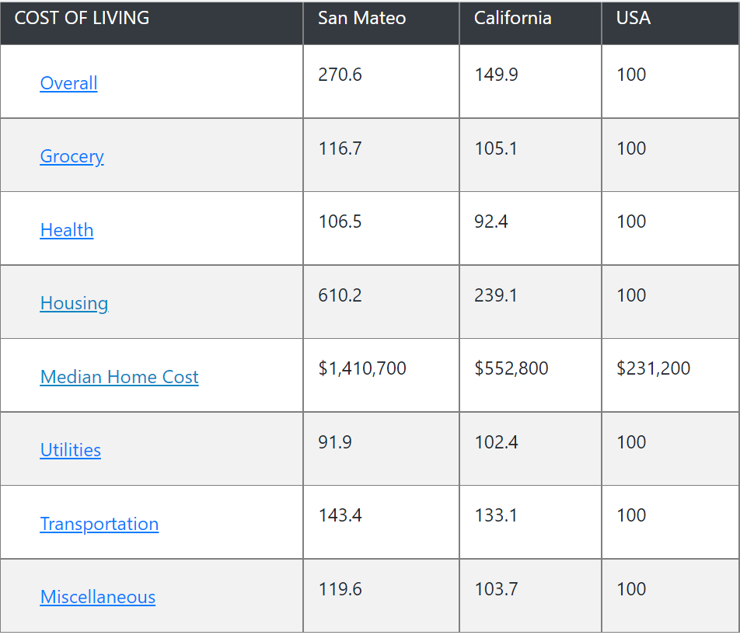
The cost of living in San Mateo County is nearly triple the national average
100 = National Average in the above chart. Source: https://www.bestplaces.net/cost_of_living/city/california/san_mateo. Bureau of Labor Statistics

Slide 10
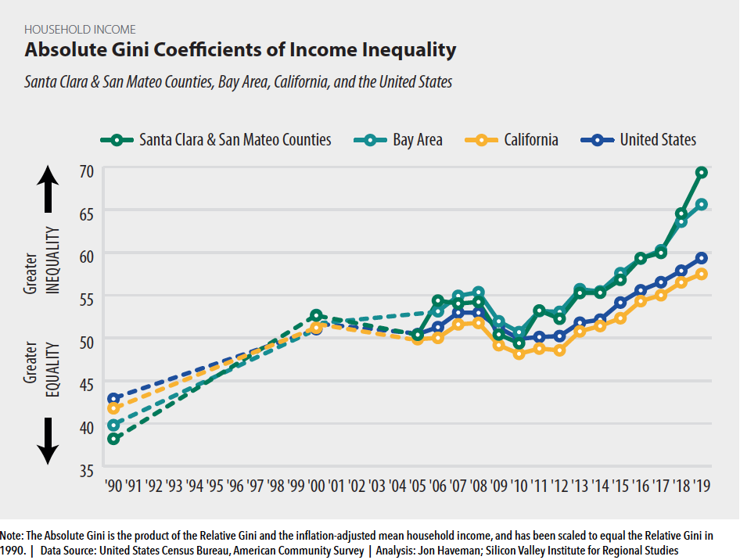

Slide 11
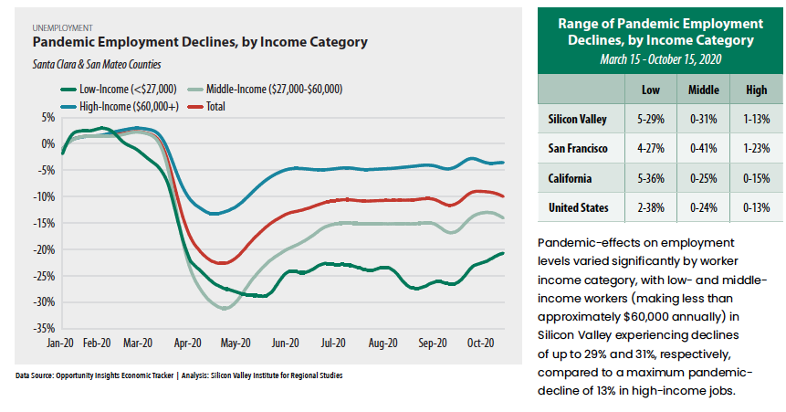

Slide 12
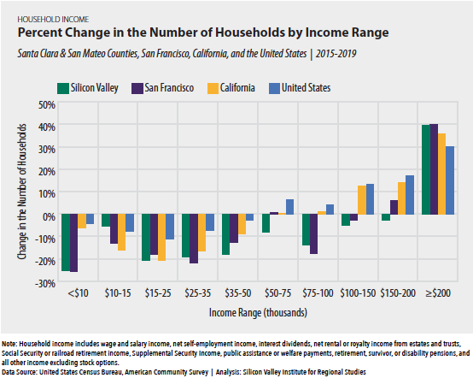

Slide 13
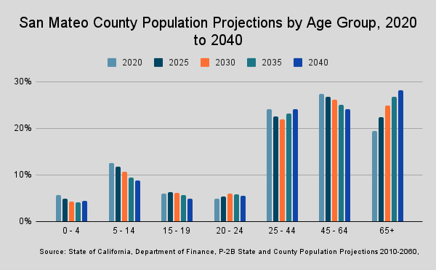

Slide 14
San Mateo County Community College District Enrollments: 2011-2021

Slide 15
Redwood City & North Fair Oaks Community Needs Assessment
Key Takeaways
HEALTHCARE INSECURITY
Always has been high (20-25%) but has not increased as much as other unmet needs since COVID.
FOOD INSECURITY
Increased dramatically and remains relatively high (15%), despite widespread awareness of multiple services.
HOUSING INSECURITY
Affects one-third of renters (30-35%), with a small but meaningful portion (7%) under eviction threat.
Spanish language respondents are six times as likely to be food insecure and twice as likely to be housing insecure
Source: Community Survey conducted spring 2021

Slide 16
Redwood City & North Fair Oaks Community Needs Assessment
Key Takeaways
DIGITAL DIVIDE
Most pronounced for high-quality technology, for example:
Lack of installed internet (15-30%)
Lack of a home computer (20-40%)
DISTANCE LEARNING
Top challenges include:
Lack of private workspace (22%)
Insufficient support from teachers or school staff (20%)
Source: Community Survey conducted spring 2021

Slide 17
Redwood City & North Fair Oaks Community Needs Assessment
Key Takeaways
SECOND SHIFT
Most full-time workers (55%) are caring for children more than 8 hours a day.
INCOME
Unemployment and furlough rates have doubled since COVID.
Source: Community Survey conducted spring 2021

Slide 18
Cañada: changing enrollment patterns during COVID…
Of our home campus students, changes from Fall 2019 to Fall 2021:
ESL | 3% down from 12% (149 total in Fall 21)
Low Income | 36% down from 48%
First Time | 13% down from 16%
Continuing | 66% up from 55%
Female | 66% up from 60%; Male: 30% down from 37%
Degree/Transfer Seeking | 66% up from 60%
Exploratory | 15% down from 22%
K-12 Students | 6% down from 8%
Overall, no significant shifts or disproportionate impact by age or race/ethnicity.
However, our low income students are disproportionately Black and/or Latinx
Home campus is defined by the SMCCCD college from which the student is seeking a degree or certificate.

Slide 19
Student preferences for instructional modalities may be shifting

Slide 20
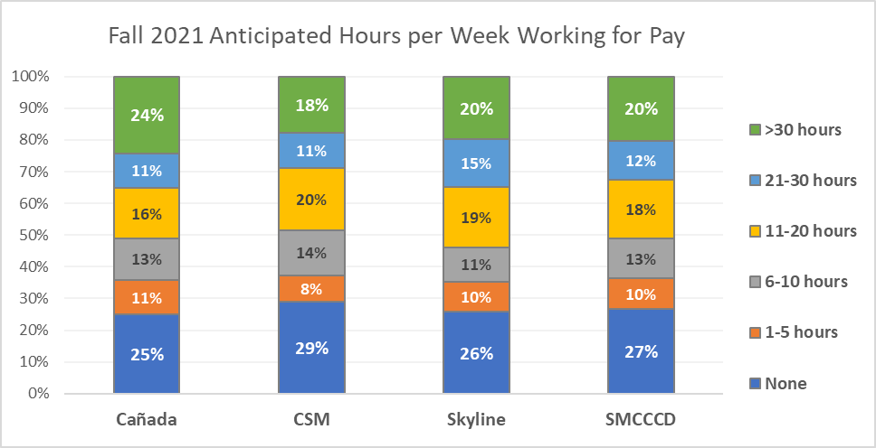
Approximately 1/3 of SMCCCD students expect to work more than 20 hours per week in Fall 2021
Q: If you do return to college in the Fall of 2021, how many hours do you anticipate working for pay?
Weekly Work for Pay
Source: SMCCCD PRIE Survey of Enrolled Students, Spring 2021 (#1)

Slide 21
Student anticipated work hours are directly and strongly correlated with their preference for instructional modality. The more students anticipate working, the more likely they are to prefer taking most of their classes online. Similarly, the less students anticipate working, the more likely they are to prefer taking most of their classes face-to-face.

Slide 22
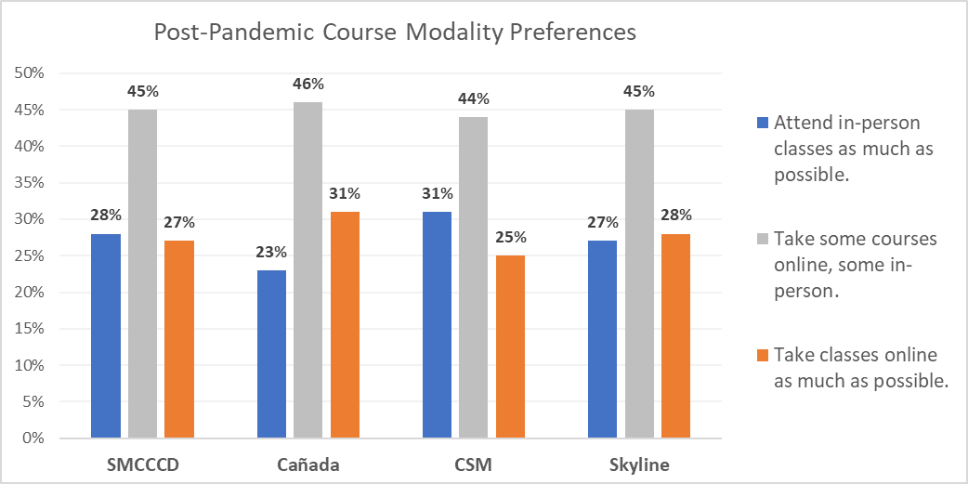
Students’ post-COVID course modality preferences are split between on-line and in person
Q: In the future, once the pandemic is behind us, which most accurately describes your preference for how to attend college?
Source: SMCCCD PRIE Survey of Enrolled Students, Spring 2021 (#1)
Notes:
Differences between Canada and CSM are statistically significant (p<.05)

Slide 23
Students who stopped out during the pandemic
More likely to Stop Out
Less likely to Stop Out
Returning students
K-12 students
Low income students
Older students
Continuing students
There were no major differences on the basis of race/ethnicity, first generation status, or gender between the Stopped Out student group and our overall population (districtwide) pre-pandemic (2019-20)

Slide 24
We've noticed you have not re-enrolled at the San Mateo County Community Colleges (Cañada, CSM, or Skyline) during the COVID pandemic. Could you please share your reasons for not returning?
 | # of survey respondents
I had to prioritize my job/work | 196
I prefer not to enroll in online classes | 190
Other | 172
I am attending college elsewhere | 135
I needed to prioritize my care for children/family | 101
I am taking a break from school for now | 95
I needed to focus on my mental health/wellness | 81
I could not (and cannot) afford to attend right now | 81
I moved out of the area | 80
I needed to focus on my physical health/wellness | 55
I do not have a quite place to study | 47
I did not feel supported while I was enrolled | 40
My Wifi and internet access are unreliable | 29
I could not find a program | 27
Students were able to select as many or as few items as they liked. Five main themes of the “Other” responses were: They had completed course requirements/graduated/transferred, they were waiting to be in person, college processes had created an impediment to their re-enrolling, various life reasons, and a lack of classes that they were interested in.
Notes:
Source: SMCCCD PRIE Districtwide survey of students who had been enrolled at any point in 2019-20 but who had not re-enrolled at any point during the pandemic (through spring 2021)

Slide 25
Demographic Breakdown of Students Selecting “I prefer not to enroll in online classes”

Slide 26
If you had both face-to-face and online/virtual options for all of the classes you might want to take, what are the three biggest obstacles to your re-enrolling at the SMCCCD Colleges next fall?
 | # of survey respondents
I need to prioritize my job/work | 134
I moved out of the area | 100
Other | 86
The course(s) I need are not offered at the time(s) I need them | 79
I need to focus on my mental health/wellness | 66
I cannot find a program of study that interests me | 64
I need to prioritize my care for children/family | 55
I need to focus on my physical health/wellness | 52
I cannot afford to attend college right now | 51
Students were able to select up to three options, of those who indicated No or Not Sure to re-enrolling. The main themes for those that selected other were transferred/graduated/completed course requirements, they have switched schools, or they prefer in person instruction.

Slide 27
What are the top 3 things the San Mateo Colleges could do to support your return to college in the future?
 | # of survey respondents
More scheduling options: getting the courses I want when I want them | 328
Financial Support | 323
Help choosing courses programs etc. | 203
Personal counseling | 152
Help with registering for courses | 146
Other | 130
Transportation to/from campus | 88
Support with technology | 86
Support with accessing food and/or housing | 82
Support with childcare | 51
Students were able to select up to three options. Of those who selected Other, over half indicated None/Not applicable, a minority indicated a return to in person instruction, and finally more diverse course offerings.

Slide 28
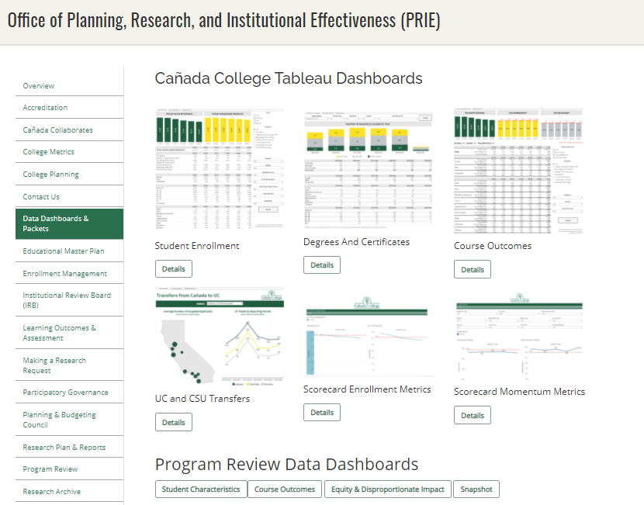
We track our progress via our newly adopted College Scorecard as well as our Data Dashboards

Slide 29
Changes in our internal environment
Cañada is the smallest of the three community colleges serving San Mateo County
College enrollments have been declining steadily for more than 10 years
The percentage of total students enrolled in the District who are seeking a degree or certificate from Cañada (as opposed to Skyline College or College of San Mateo) is declining
The share of full-time equivalent students at Cañada is the smallest among the College’s peers across the State
Before the pandemic, Cañada had placed nearly 25% of its sections online as a way to capture enrollments (primarily from Skyline and CSM students)
Now, with most sections across the District online, Cañada is losing enrollments to Skyline and CSM
Cañada has a number of student support programs that help students persist and complete courses and programs successfully, but equity gaps across student groups remain
In short: the pandemic has exacerbated the College’s pre-existing enrollment and student success challenges

Slide 30
Enrollment Metrics

Slide 31
Until this term, Cañada’s headcount has been stable

Slide 32
Enrollments continue to drop: -20%

Slide 33
The number of units our students take is extremely low
Compared to 38 of its peers, Cañada has the lowest % of
full time equivalent students
Source: IPEDS Report Data
Notes:
IPEDS Report Data College Headcount: 2019-20 FTE: 2019-20 Ratio Canada College 9575 2382 25% Skyline College 14900 4394 29% College of San Mateo 12649 4120 33% Allan Hancock College 16609 6654 40% College of the Canyons 32974 12473 38% Chabot College 19951 7966 40% Cıtrus College 18592 9611 52% Cıty College of San Francısco 35153 13833 39% Cosummes Rıver College 21511 9172 43% Cuesta College 15810 6214 39% De Anza College 28029 13982 50% College of the Dessert 15367 7764 51% Diablo Valley College 29307 12876 44% Glendale Community College 18781 11602 62% Golden West College 18515 7556 41% Grossmont College 23927 10076 42% Irvine Valley College 18862 8494 45% Reedley College 19189 6736 35% Los Angeles Pierce College 28007 11819 42% Los Angeles Trade Technical College 21565 7286 34% Los Angeles Valley College 26867 9476 35% Los Angeles City College 26967 9476 35% Merced College 15302 7469 49% Moorpark College 20631 9487 46% Mt. San Jacinto Community College 21606 10057 47% Orange Coast College 26295 12663 48% Saddleback College 33140 12621 38% San Diego City College 22977 7357 32% San Diego Miramar College 23038 7066 31% San Joaquin Delta 26150 15238 58% Santa Barbara City College 20624 10254 50% Santa Rosa Junior College 27223 10801 40% College of the Sequias 16379 8581 52% Sierra College 25731 11966 47% San Bernandino Valley College 20297 9178 45% Southwestern College 26197 12541 48% Ventura College 18487 7669 41% Victor Valley 17862 8365 47% Norco College 17543 6319 36% Averege of 38 similar CCCs 22185 9453 43% Total 843014 359212 43%

Slide 34
During the pandemic, our home campus students are taking fewer units here at Cañada

Slide 35
During the pandemic, more students are “swirling”

Slide 36
A smaller share of Cañada students are seeking a degree or certificate from Cañada
Total: 6,223
Total: 6,048
Total: 4,334
Home campus is defined by the college from which the student is seeking a degree or certificate.

Slide 37
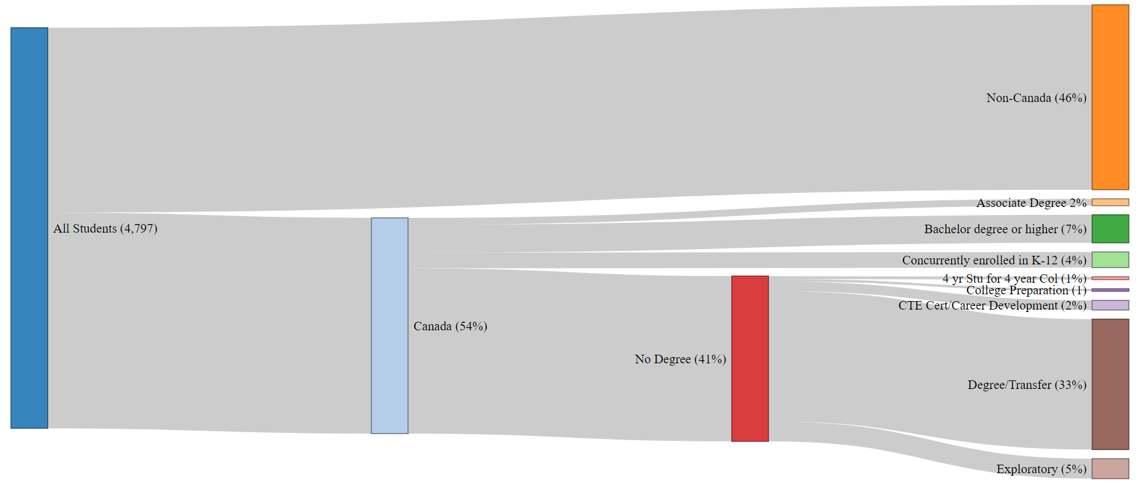
Fall 2020 CAN Enrolled Students by Home Campus, Education Level & Education Goal
Notes:
file:///C:/Users/engelk/OneDrive%20-%20San%20Mateo%20County%20Community%20College%20District/Enrollment%20Management/FA19FA20%20Sankey.html

Slide 39
Access for Low Income Students

Slide 40
Student Momentum Metrics

Slide 41
Students completing a comprehensive Ed. Plan

Slide 42
Part-time students less likely to complete any SEP

Slide 43
Overall Course Completion Rates

Slide 44
Population metrics highlighted in red indicate those groups disproportionately negatively impacted. This is where the College is seeing equity gaps.

Slide 45
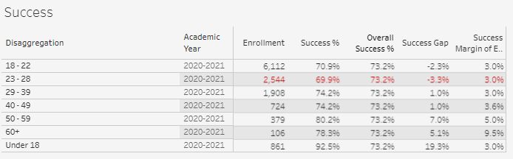
Population metrics highlighted in red indicate those groups disproportionately negatively impacted. This is where the College is seeing equity gaps.

Slide 46
Population metrics highlighted in red indicate those groups disproportionately negatively impacted. This is where the College is seeing equity gaps.

Slide 47
Population metrics highlighted in red indicate those groups disproportionately negatively impacted. This is where the College is seeing equity gaps.

Slide 48
Students completing transfer level math and English within one year of enrolling

Slide 49
Persistence
 | Fall 2020 to Spring 2021 | Fall 2020 to Fall 2021
Overall persistence rates | 64% | 40%
Term Ethnicity Desc | SP21 | FA21
American Indian/Alaskan Native | 50% | 50%
Asian | 63% | 37%
Black - Non-Hispanic | 47% | 35%
Filipino | 56% | 39%
Hispanic | 65% | 41%
Multiraces | 69% | 42%
Pacific Islander | 63% | 38%
Unknown | 64% | 44%
White Non-Hispanic | 64% | 37%
Student Low Income | SP21 | FA21
Yes | 66% | 42%
No | 62% | 37%
Enrollment Status Desc | SP21 | FA21
Continuing Student | 66% | 41%
First-Time Student | 76% | 55%
First-Time Transfer Student | 55% | 33%
Not Applicable, Currently K-12 | 62% | 33%
Returning Student | 45% | 29%
Returning Transfer Student | 46% | 21%
‡ Spring 2020, Summer 2020, Fall 2020, and Spring 2021 were impacted by Covid 19 and may not be representative of a typical academic year

Slide 50
Students persist from fall to spring at higher rates with the support of special programs (Promise, EOPS, College for Working Adults, ESO Adelante, Puente, COLTS)
 | Persistence
 | Special Program | No Special Program
Full Time | 95% | 79%
Part Time | 83% | 52%
Low Income | 95% | 71%
Asian | 100% | 67%
Black - Non-Hispanic | 100% | 25%
Filipino | 100% | 100%
Hispanic | 91% | 61%
Multiraces | 100% | 67%
Pacific Islander | 100%
Unknown | 100% | 75%
White Non-Hispanic | 100% | 71%
Fall 2020 first time cohort

Slide 51
Students are able to succeed in a higher number of units with the support of special programs (Promise, EOPS, College for Working Adults, ESO Adelante, Puente, COLTS)
 | % of Units Taken Successful
 | Special Program | No Special Program
Full Time | 55% | 53%
Part Time | 52% | 47%
Low Income | 55% | 45%
Asian | 54% | 60%
Black - Non-Hispanic | 100% | 43%
Filipino | 61% | 86%
Hispanic | 51% | 44%
Multiraces | 58% | 48%
Pacific Islander | 100%
Unknown | 76% | 61%
White Non-Hispanic | 61% | 56%
Fall 2020 first time cohort

Slide 52
Completion Metrics

Slide 53
Degree Completion
Note: Degree and certificate awards in 2020-21 are anticipated to be higher than the last 5 years, but they are still being evaluated, so the number reported above is preliminary (those actually awarded).

Slide 54
# of unduplicated students who earn an associate degree within

Slide 55
Transfer Outcomes
Student groups under-represented in the transfer group in 2019-20
Source: National Student Clearinghouse. CAN PRIE Analysis. ‡ Spring 2020, Summer 2020, Fall 2020, and Spring 2021 were impacted by COVID 19 and may not be representative of a typical academic year

Slide 56
For more information please see the Planning, Research & Institutional Effectiveness website here: https://canadacollege.edu/prie/

